Slide 1

Welcome
Friday, February 2, 2024

Slide 2
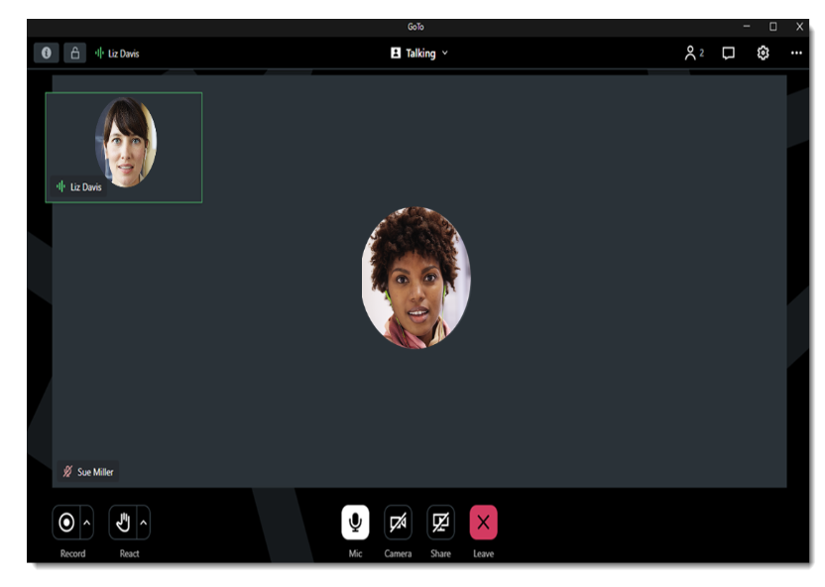
GoToMeeting Housekeeping: What You See as an Attendee
Change your view and how you see participants and speakers
Chat box
Raise your hand and other reactions
Mic (mute) and Camera

Slide 3
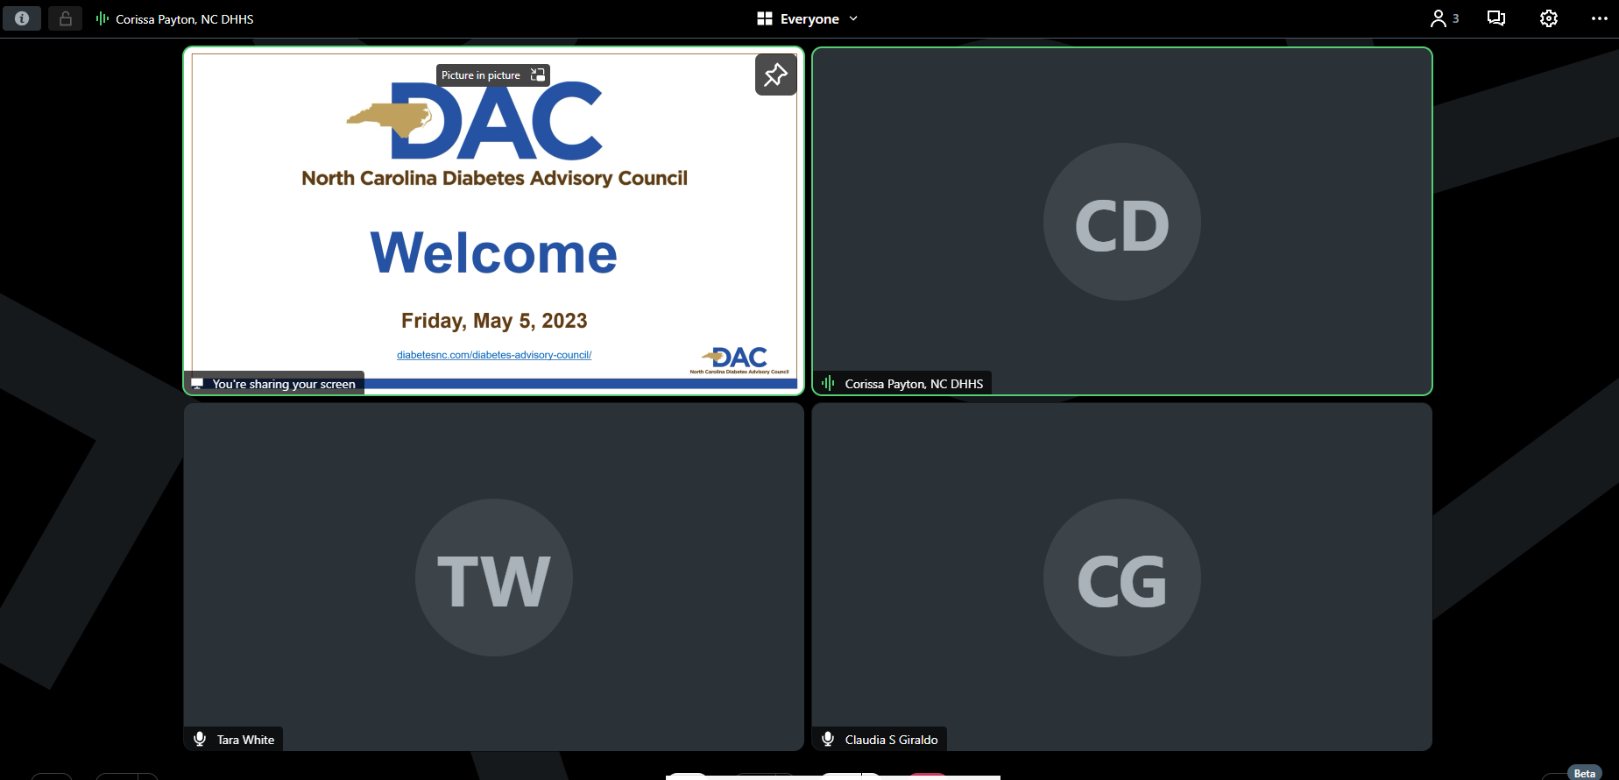
GoToMeeting Housekeeping: What You See as an Attendee
Use the Push Pin icon to pin the slideshow to make it the main screen

Slide 4
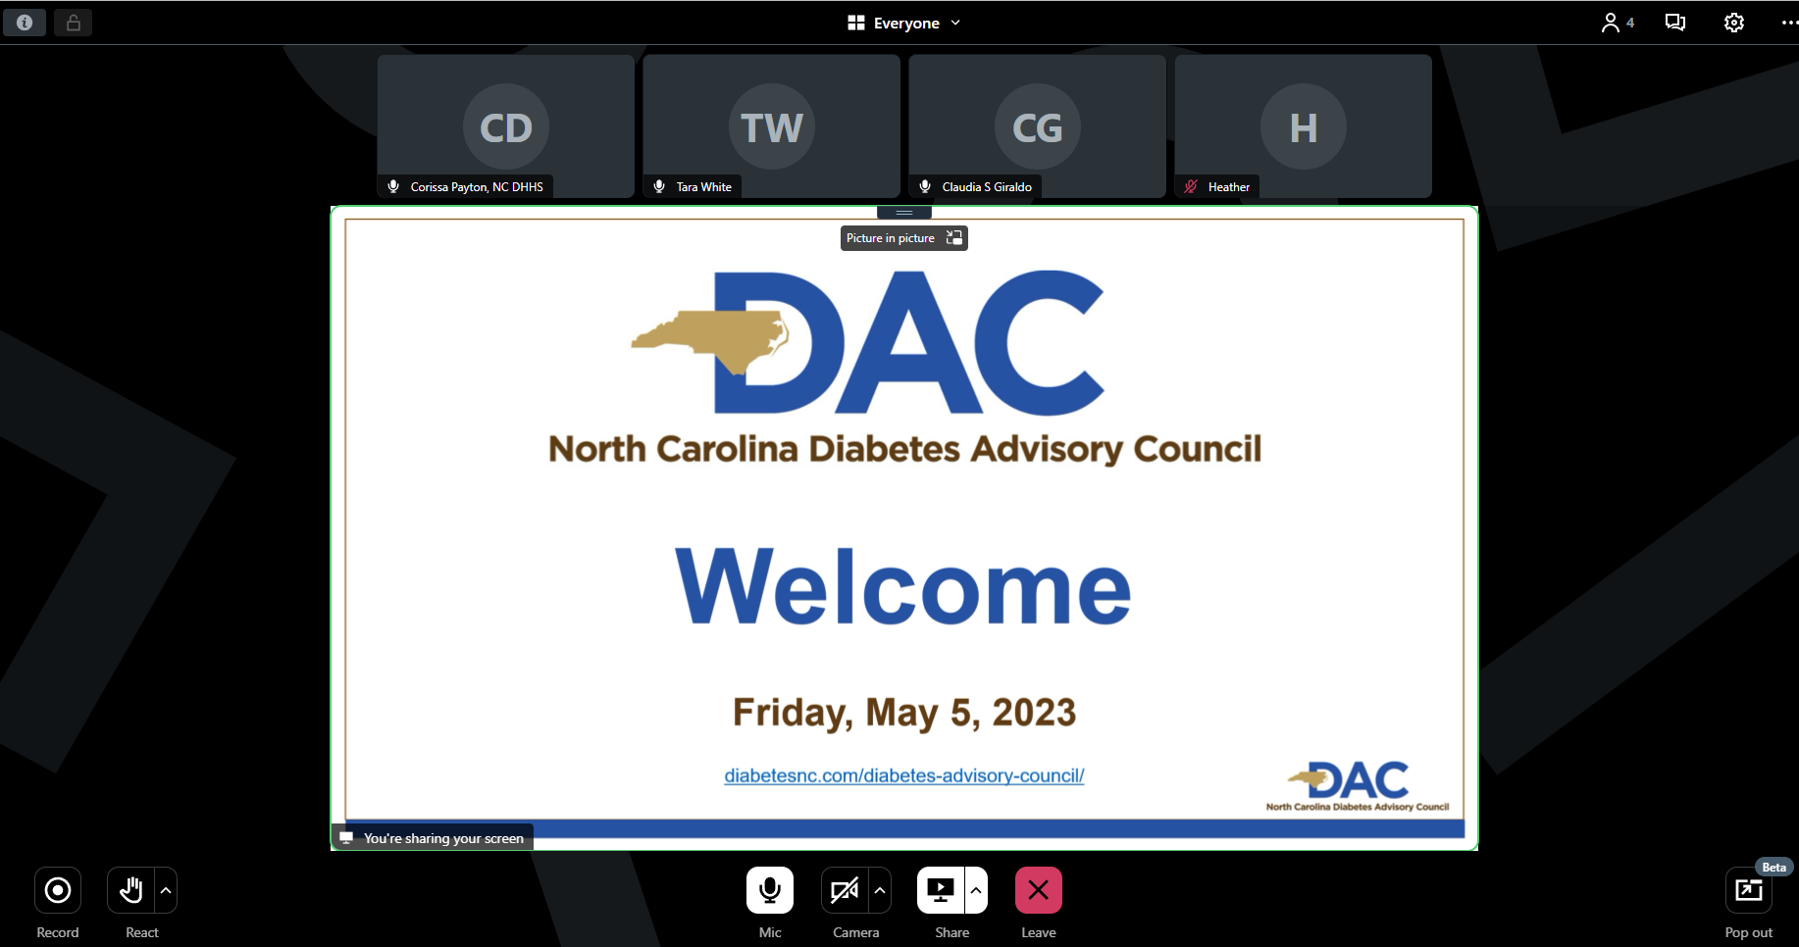
GoToMeeting Housekeeping: What You See as an Attendee
Then it should be the main screen

Slide 5
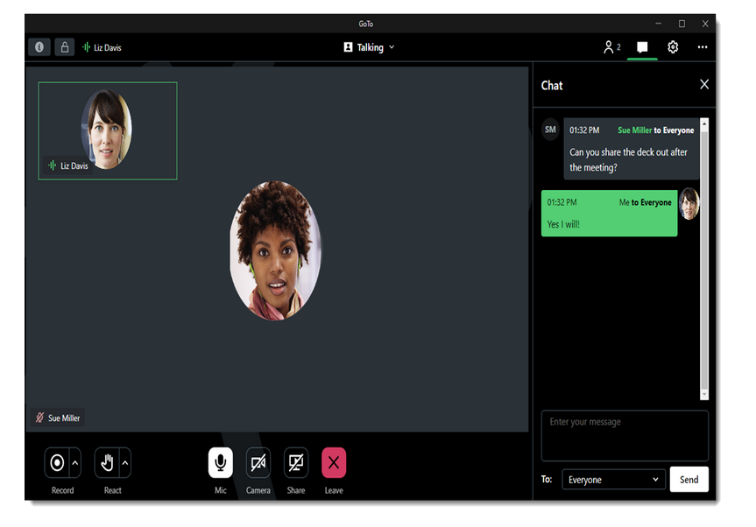
Roll Call
Please enter the following information in the chat for our attendance records:
Name
Organization/Affiliation
Email Address
diabetesnc.com/diabetes-advisory-council/

Slide 6
Agenda
Welcome, Introductions and Review and Approval of October 2023 Highlights
Announcements
Diabetes Advocacy – Diabetes Leadership Council
Break
Diabetes Performance Improvement Plan – Division of Health Benefits
Diabetes Medication Update
AHEC Digital Library
Workgroup Breakout Sessions

Slide 7
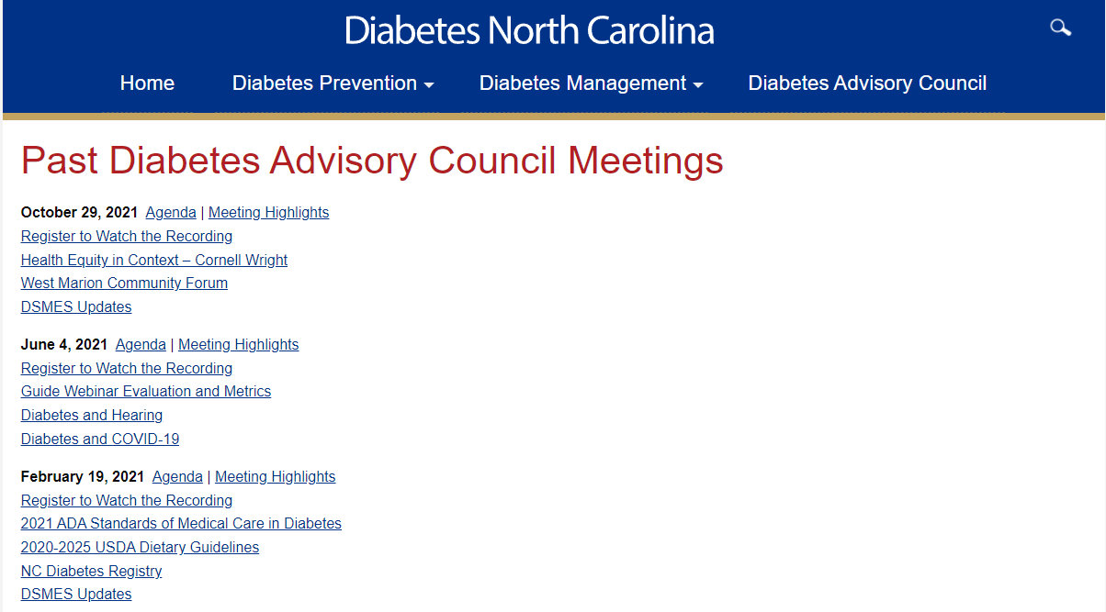
diabetesnc.com/diabetes-advisory-council/

Slide 8
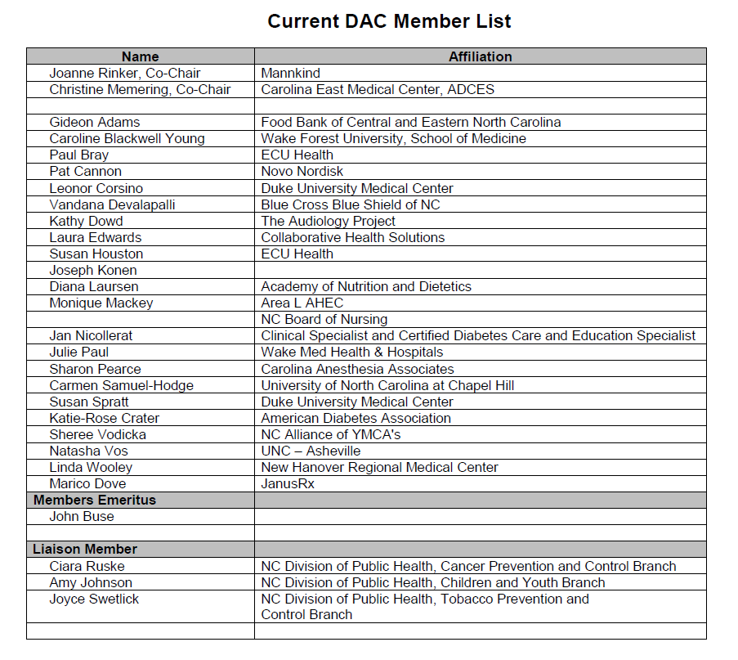
DAC Voting Members

Slide 9
Announcements
Chris Memering
Joanne Rinker

Slide 10
2024 DAC Meeting Dates
February 2, 2024
May 17, 2024
October 18, 2024*
All meetings will be held at the McKimmon Center in Raleigh
with a virtual option.

Slide 11
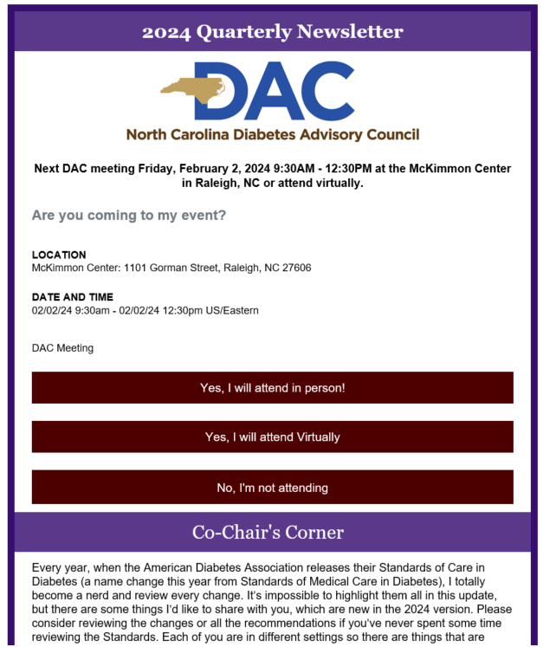
DAC Newsletter
Thank you to Dr. Rashim Gupta, Endocrinologist at Whole Endo, for being our first contributor with article on Diabetes Distress.

Slide 12

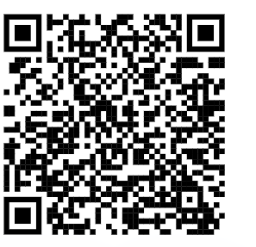
Virtual Public Policy Forum
Public Policy Forum (PPF) Training: Wednesday, March 6 | 12:00-5:00pm
Hill Day: Thursday, March 7 | 8:00am – 5:30pm
Attendees ay register for either the March 6 training only or for BOTH the training and Hill Day. Registration is encouraged by February 22.

Slide 13
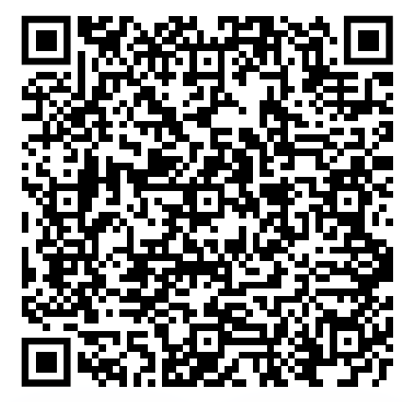
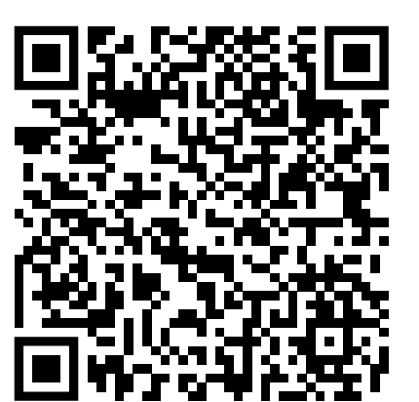
Diabetes Conferences - NC
Diabetes Care and Education Conference 2024
March 1, 2024 7:30am – 4:30pm
Greenville, NC or via Live Webinar
Conference and Registration Information
36th Annual Diabetes Conference: Reducing the Burden and Living Well with Diabetes
April 19, 2024 7:45am – 4:00pm
Concord, NC or via Live Webinar
Conference and Registration Information

Slide 14
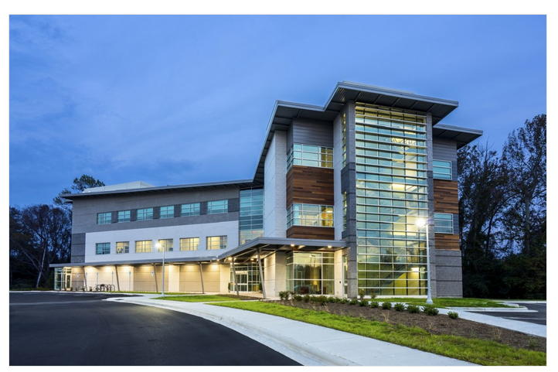
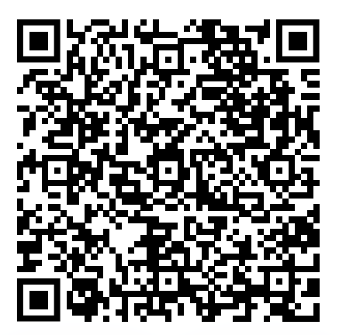
A-Z Diabetes Boot Camp
May 6 – 10, 2024
Greenville, NC
A week-long, in depth course designed to enhance the health care professional’s knowledge of diabetes and promote patient and family centered partnerships in self-management and support.
Conference and Registration Information

Slide 15

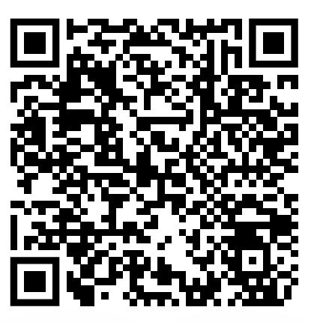

Diabetes Conferences - National
ADA 84th Scientific Sessions
June 21-24, 2024
Orlando, FL or Online
Conference and Registration Information
ADCES24
August 9-12, 2024
New Orleans, LA or Online
Registration and housing open in March

Slide 16

Community Event
Winning with Diabetes is an all day event for people with diabetes and their families/friends. It is designed to help support and engage them in living well with diabetes. Local experts will speak about diabetes management and empower people to make positive lifestyle changes.
Notes:
Susie Houston

Slide 17

DPP Updates
Meg Sargent
Diabetes Prevention Program Coordinator
North Carolina Division of Public Health
Meg.sargent@dhhs.nc.gov

Slide 18
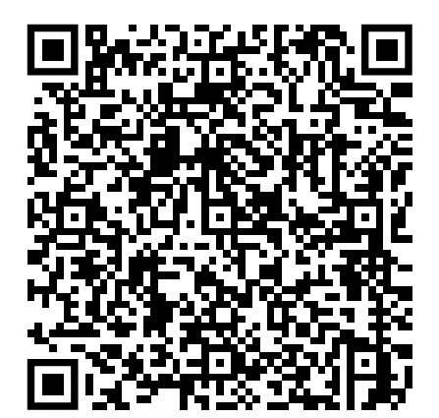
Special Opportunity for Accelerated Medicare DPP Recognition
ADA-recognized and ADCES-accredited DSMES organizations have a special opportunity to accelerate participation in the Medicare Diabetes Prevention Program by fast-tracking to preliminary recognition
Skips 12-18 months at pending recognition (when you’re not eligible to bill)
Application due by February 9 (indicate you’re an ADA or ADCES DSMES provider)
Opportunities for DPP Lifestyle Coach Scholarships
Those sites currently at pending recognition will also be fast-tracked to preliminary recognition by emailing NationalDPPAsk@cdc.gov
Reach out to Meg Sargent, DPP Coordinator for DHHS, for technical assistance and information on Lifestyle Coach trainings
Meg.Sargent@dhhs.nc.gov

Slide 19
Diabetes Advocacy
Erin Callahan and Stewart Perry
Diabetes Leadership Council

Slide 20
Break
10 minutes

Slide 21
Diabetes Performance
Improvement Plan
Brianne Davis
Nurse Quality Improvement Manager
Division of Health Benefits

Slide 22
NC Department of Health and Human Services
North Carolina Standard Plan
Diabetes Management Collaborative at the Diabetes Advisory Council Meeting
February 2, 2024
Nurse QI Manager- Quality Management-Quality Improvement
Brianne Davis, MSN, APRN, CSM, SSM, CSSYB

Slide 23
Agenda
Performance Improvement Projects (PIP) Background
Diabetes Management Collaborative Mission and Aim Statement
Measuring Improvement
Diabetes Self- Management Education Support Services (DSMES) Intervention Effectiveness Measures
Notes:
https://www.macpac.gov/subtopic/quality-requirements-under-medicaid-managed-care/

Slide 24
Performance Improvement Project Background

Slide 25
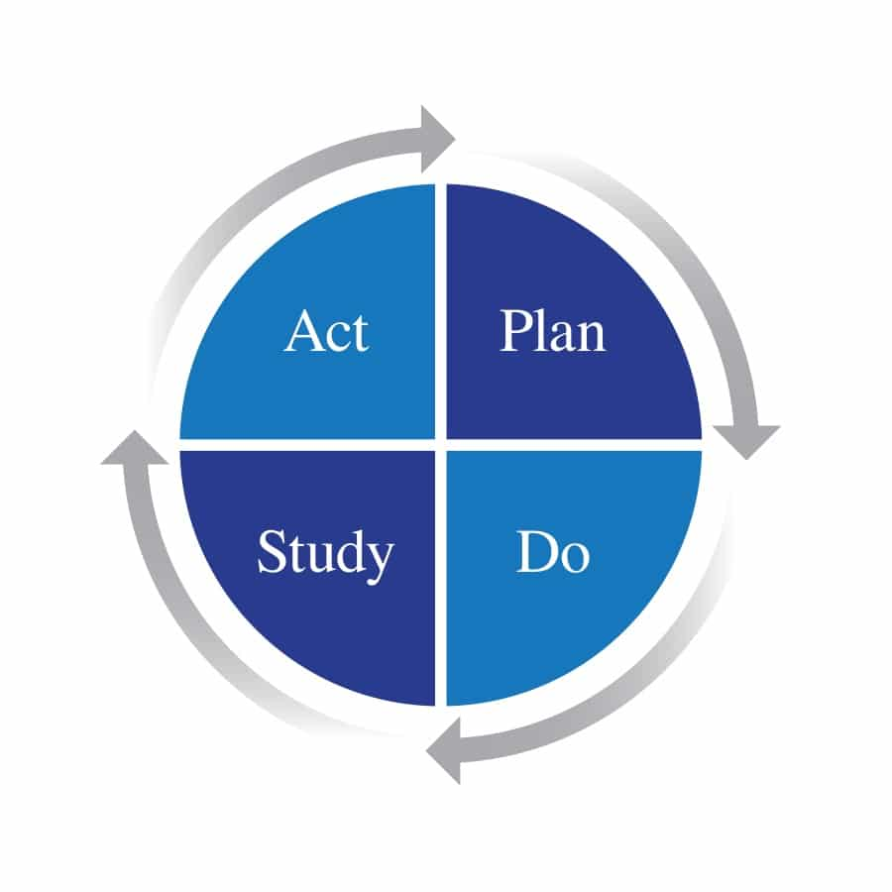
Performance Improvement Projects Background
As part of a comprehensive quality assessment and performance improvement (QAPI) program, states must require managed care plans to implement performance improvement projects (PIPs).
States must require plans to conduct clinical and nonclinical performance improvement projects to examine access to and quality of care.
Notes:
https://www.macpac.gov/subtopic/quality-requirements-under-medicaid-managed-care/

Slide 26
Performance Improvement Projects
Standard Plans are required to conduct Performance Improvement Projects (PIPs) that:
Designed to achieve significant improvement, sustained over time, in health outcomes and enrollee satisfaction
Include measurement of performance using objective quality indicators;
Include implementation of interventions to achieve improvement in access to and quality of care;
Include evaluation of the effectiveness of the interventions; and
Include planning and initiation of activities for increasing or sustaining improvement.
Address disparities and promote health equity

Slide 27
Standard Plan PIPs
Child and Adolescent Immunizations
Diabetes Management in Adults
Prenatal and Postpartum Care
Health Related Resource Needs Screening

Slide 28
Diabetes Management Learning Collaborative

Slide 29

Diabetes PIP Collaborative Mission
The Collaborative seeks to elevate and transform diabetes care in NC through strategic partnerships, data-driven improvements, and a commitment to sustainable health outcomes and member empowerment.

Slide 30
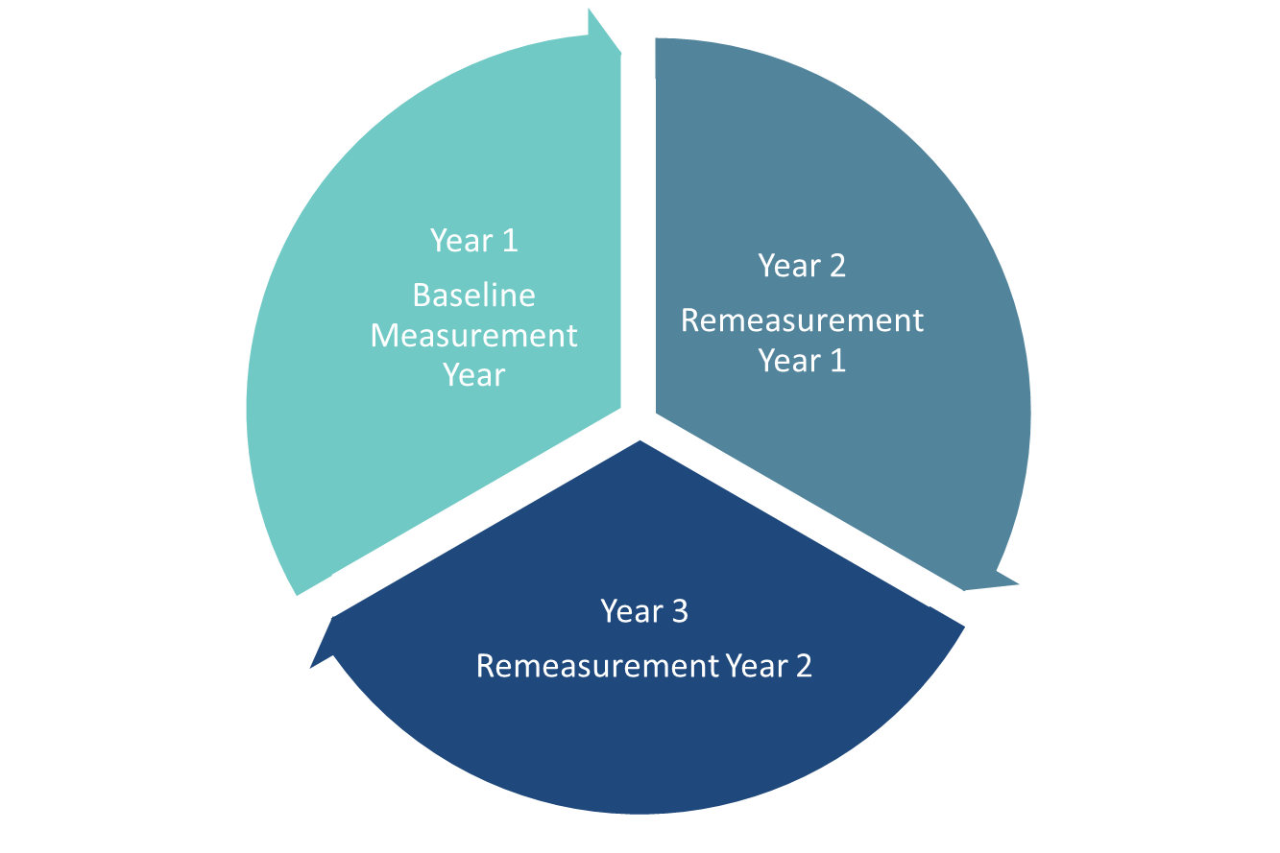
Diabetes Management Collaborative Aim Statement
The North Carolina Standard Plan Diabetes Management Collaborative aims to improve performance by 1.67% for each year for 3 years relative to aggregate Standard Plan performance through targeted interventions.

Slide 31
Measuring Improvement
Notes:
Looking at two different populations – those with glycemic control and those who do not have glycemic controls

Slide 32
DHB’s Move to Improve the Diabetes PIP CY2024
The Diabetes Care PIP Primary Indicator will be expanded to encompass both sub measures for GSD.
Glycemic Status (<8.0%) and Glycemic Status(>9.0%)
Due to data quality issues for the GSD measure (formally HBD), DHB has elected to provide the plans with the following intervention effectiveness measures to optimize members health outcomes and data collection.
Standard Plans adopted Diabetes Self-Management Education Classes (DSMEs) as the first intervention effectiveness measure.
Notes:
Brianne

Slide 33
DHB Recommended Intervention Effectiveness Measures
Education and Lifestyle Interventions:
  Diabetes management classes: Structured sessions aimed at educating patients about diabetes management. Medication adherence, and lifestyle modifications.
  Nutrition counseling: Personalize medical nutrition therapy with a registered dietitian or certified nutritional professional
  Value Added Services (VAS): DHB recommends each plan utilizing their VAS and tailoring it to meet the unique needs of diabetic beneficiaries to enhance their overall care experience and participation to improve his/her health.
Diabetes Management and Monitoring:
  Diabetes-associated conditions testing: Regular screenings and test to detect and manage potential complications and comorbid conditions associated with diabetes.
Notes:
Collaborated with DPH and external partners to discuss strategies to address implementing the DSMES intervention effectiveness measures

Slide 34
Diabetes Self- Management Education Support Services (DSMES) Intervention Effectiveness Measures

Slide 35
Implementation of DSMES Effectiveness Measures
The percentage of AMH Tier 1 and Tier 2 diabetic members in care management with a most recent glycemic status (hemoglobin A1c [HbA1c] or glucose management indicator [GMI]) greater than 9.0 percent successfully contacted and educated on the availability of DSMES classes.
Measure 1
The percentage of AMH Tier 1 and Tier 2 diabetic members in care management with a with a most recent glycemic status (hemoglobin A1c [HbA1c] or glucose management indicator [GMI]) greater than 9.0 percent successfully contacted, educated, and attended greater than 2 hours of DSMES classes.
Measure 3
The percentage of AMH Tier 1 and Tier 2 diabetic members in care management with a most recent glycemic status (hemoglobin A1c [HbA1c] or glucose management indicator [GMI]) greater than 9.0 percent successfully contacted, educated, and attended less than or equal to two hours of DSMES classes.
Measure 2
Notes:
Targeted Population: Standard Plans (SPs) Advanced Medical Health (AMH) Tier 1 and Tier 2 diabetic members within care management that has a most recent glycemic status (hemoglobin A1c [HbA1c] or glucose management indicator [GMI]) greater than 9.0% GSD measure specifications.

Slide 36
Q & A
Notes:
Plans promotion of the classes
Ways to incentivize the members to attend the classes
Value that these classes bring.

Slide 37
Maximizing Engagement in DSMES Classes
1. Promotion of Diabetes Education Classes:
What recommendations can you provide for health plans to effectively promote the availability of Diabetes Self-Management Education Support services classes?
2. Incentivizing Participation:
What incentives would be most effective in encouraging full participation in Diabetes Self-Management Education Support services classes, based on your experience?
3. Communication of Value:
How can we best communicate the value of Diabetes Self-Management Education Support services classes to the community and encourage participation?
4. Enhancing Utilization and Understanding:
Considering the novelty of these interventions, what are your insights on enhancing understanding and utilization among our diabetic members?

Slide 38
Closing
Notes:
Plans promotion of the classes
Ways to incentivize the members to attend the classes
Value that these classes bring.

Slide 39
Stay in Touch: Key Contacts for Continuous Collaboration
Primary Contact: Brianne Davis, MSN, APRN- Nurse Quality Improvement Manager
  brianne.davis@dhhs.nc.gov
Secondary Contact: Chelsea Gailey, MPH- Senior Manager of Quality Improvement – Quality Management
  chelsea.gailey1@dhhs.nc.gov

Slide 40
Diabetes Medication Updates
Marico Dove, PharmD
JanusRx

Slide 41
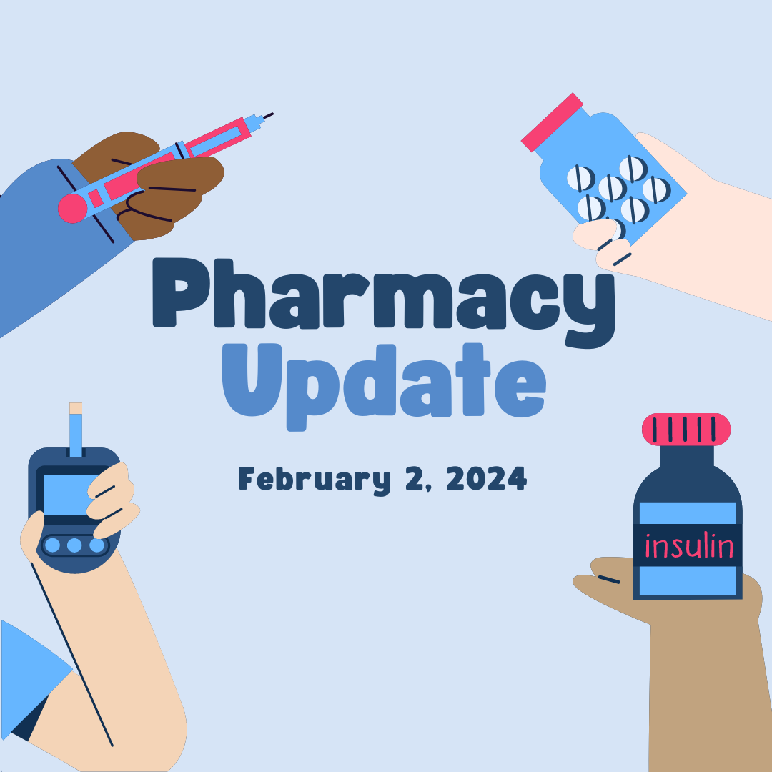
NC Diabetes Advisory Council
Raleigh, NC
Marico Dove, PharmD
February 2, 2024
Notes:
My name is Dr. Marico Dove. I am a Pharmacist and I’d like to thank the council for allowing me to share some pharmacy-related updates.

Slide 42
Objectives
1
2
3
Discuss general pricing of commonly used insulin products
Review important information to consider when prescribing insulin products
Identify recently approved drugs for treatment of types 1 and 2 diabetes

Slide 43

General Insulin Prices/Copays
Rapid Acting
Short Acting
Insulin Aspart (Novolog)
Insulin Lispro (Humalog)
Novolin R, Humulin R
Intermediate Acting
Long Acting
Novolin N, Humulin N
Insulin Detemir (Levemir)
Insulin Glargine (Lantus, Basaglar)
Medicaid: $4
Medicare: $35
Private Insurance: varies
Non-Insurance: $14.03 - $568.58¹
Prices. Coupons & Savings Tips. Goodrx.com. Accessed 1/21/24
Ahunna Freeman, PharmD, BCGP. Southside Discount Pharmacy. Winston-Salem, NC. 1/23/23.
Notes:
This list is not all inclusive. The listed products may be available as either a vial, a pen, or both. This list does not include combination products or non insulin injectables for tx of t2d (ex. Ozempic, Mounjaro, Trulicty, etc.) Medicaid copays are up to $4. Medicare copays are not supposed to exceed $35 for a 1-month supply. Deductibles are not supposed to be applied to the Medicare copays for insulin.
Private Insurance Copays depend on the plan. https://www.fepblue.org/pharmacy/prescriptions
Out of Pocket costs included on this slide depends on pharmacy but generally range from:
In most cases insulin pens are more expensive than vials, there are usually more units of insulin in one pack of 5 pens than in 1 vial.
https://www.medicare.gov/about-us/prescription-drug-law#:~:text=You'll%20pay%20%2435%20(or,insulin%20coverage%20under%20Part%20D%3F

Slide 44


Important Things to Consider When Prescribing Insulin
Affordability
Availability
Quantity
Example:
Tresiba (degludec) 100 units/mL pen
1 box = 5 pens = 15mL = 1500 units
Tresiba (degludec) 200 units/mL pen
1 box = 3 pen = 9mL = 1800 units
Patient Education & Training
GOT NEEDLES???????
Notes:
Does patient have pharmacy insurance? Medical insurance does not necessarily mean they have pharmacy insurance. If they patient does not have pharmacy insurance then prescribe what the patient can afford or the medication will not be picked up and used. If the pt does have insurance, what do they cover, what is on the formulary? Prescribe whatever is on the formulary that is medically and clinically appropriate. Keep in mind insurance formularies do change periodically.
Is there a shortage of the drug? If there is a shortage be prepared to prescribed an alternative.
Qty: be specific about how much you are prescribing. If you are not sure how the insulin comes then phone a pharmacist friend. Keep in mind some pharmacies do NOT break boxes or dispense single pens.
Whenever insulin is being prescribed for the first time and periodically the provider really needs to initiate or delegate patient education & training on how to properly administer the insulin to set the patient up for success.
Every time insulin is prescribed there needs to be a separate prescription for needles. Pen needles for insulin pens and insulin syringes for insulin vials. Insurance will normally cover needles with a prescription. If there is not a prescription then the out of pocket cost for a box of 100 needles may be around $50 depending on which retail pharmacy is being used.

Slide 45
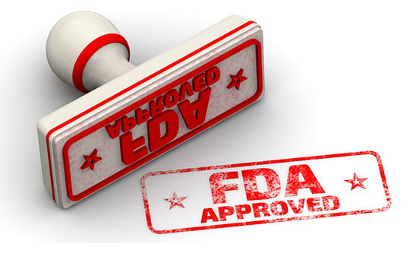
Latest FDA Approvals
Zituvimet Tablets
(metformin and sitagliptin)
Approved: 11/23
Zituvio Tablets
(sitagliptin)
Approved: 10/23
Lantidra Cellular Infusion Suspension
(donislecel-jujn)
Approved: 6/2023
Notes:
Zituvimet contains both the biguanide (metformin) and dipeptidyl peptidase-4 inhibitor (sitagliptin). As a reminder, DPP4 inhibitors essentially slow the inactivation of incretin hormones which results in decreased glucagon production and therefore decreased glucose production. Zituvimet is indicated as an adjunct to diet and exercise in improving “glycemic control in adults with type 2 diabetes mellitus.” Basically a me-too drug and is the same as Janumet including the strengths. https://www.drugs.com/newdrugs.html
Zituvio is a DPP4-inhibitor and contains the active ingredient sitagliptin. Sitagliptin alone is active ingredient in Januvia. Same as Januvia including same strengths.
“Lantidra (donislecel-jujn) is an allogeneic pancreatic islet cellular therapy for the treatment of type 1 diabetes mellitus in adults whose symptoms are not well controlled.” - https://www.drugs.com/newdrugs-archive/2023.html
Nothing in pipeline (for tx of t1d or t2d) as of 1/21/24

Slide 46
Thank You!
Credits: This presentation was created with Slidesgo and Freepik.

Slide 47
AHEC Digital Library
Janice Moore, AHEC

Slide 48

Orientation
Library Services
Janice Moore, MLS
Professional Outreach Librarian
Ph: 336-618-0310
jdmoore@wakehealth.edu
Notes:
Northwest AHEC serves 17 counties.
Some of the services we provide are:
Document Delivery
Interlibrary Loan
Literature Searches-by using medical databases those include MEDLINE, CINAHL, PUBMED
One on One Training to Access Information
Please do not google for information. You have evidence-based information available through many healthcare resources.

Slide 49
Northwest AHEC Serves 17 Counties
Some of the services provided:
Document Delivery
Interlibrary Loan
One on One Training to Access Information
Literature Searches-Using Medical Databases
  Medline
  CINAHL (Cumulative Index Nursing Allied Health Literature
  PubMed
  NCLive
  Please do not Google for information. You have evidenced-based information available through many healthcare resources

Slide 50
Objectives (Evidence-Based Resources)
Review the AHEC Digital Library website
Review NC Live website
Review Medlineplus.gov
Notes:
Our Objectives

Slide 51
North Carolina AHEC Digital Library
https://library.ncahec.net/
-Journals
-eBooks
-Health Topics
-Research Guides
-CPD
-Patient Education
-Services
Notes:
Library Links--
Ask a Question
The first resource is the AHEC Digital Library. (ADL) is your portal to AHEC library services, information, and education. The ADL ensures that all providers in the state have high-quality health information readily available through a variety of membership categories, ranging from access to free resources to paid subscriptions. By using the ADL, you can get full-text journals, books, and electronic databases of the literature, as well as links to carefully evaluated health information websites and clinical and educational tools. You have access because you are under UNC of Chapel

Slide 52
AHEC Digital Library (ADL)
The ADL is a portal to AHEC library services, information, and education. The ADL ensures that all providers in the state have high quality health information readily available through a variety of membership categories, ranging from access to free resources to paid subscriptions. By using the ADL, you can get full-text journals, books, and electronic databases of the literature, as well as links to carefully evaluated health information websites and clinical and educational tools.
Free resources
Paid Subscriptions

Slide 53
NC Live
https://www.nclive.org/
-Scholarly Articles
-News and Magazines Articles
-eBooks
-Videos
Notes:
NC LIVE is North Carolina’s statewide library for online resources.
All North Carolinians may use NC LIVE resources through their local library. These online resources are designed for at-home use and are available from any internet connection via library websites, and through nclive.org. (This is a free resource.)
The way you access NC Live resources is by using a Library Card. You may access a Library Card through your public local library.

Slide 54
NCLIVE
NCLive is North Carolina’s statewide library for online resources.
All North Carolinians may use NCLive resources through their local library. These online resources are designed for at-home use and are available from any internet connection via library websites, and through nclive.org. (This is a free resource).
The way to access NCLive resources is by using a Library Card. You may access a Library Card through your public library.

Slide 55
MedlinePlus
https://medlineplus.gov/
-Health Topics
-Drugs & Supplements
-Medical Tests
-Videos and Tools
Notes:
This a free resource with no password and no advertisement.
MedlinePlus is a service of the National Library of Medicine (NLM), the world's largest medical library, which is part of the National Institutes of Health (NIH).
MedlinePlus is an online health information resource for patients and their families and friends.
So just remember there are health resources that are credible, reliable, and trustworthly.
AHEC DIGTAL LIBRARY-some free resources and passwords for paid subscriptions
NCLIVE-resources are available to all North Carolinians with password through your public library
MEDLINEPLUS-Free for everyone to access with no password

Slide 56
MedlinePlus
This is a free resource with no password and no username.
It has no advertisement
MedlinePlus is a service provided by the National Library of Medicine (NLM), the world’s largest medical library, which is part of the National Institutes of Health (NIH).
MedlinePlus is an online health information resource for patients and their families, and friends.

Slide 57
References
Carpenter Library (WF) webpage:
http://www.wakehealth.edu/Library/
MedlinePlus:
https://medlineplus.gov/
NC Live:
https://www.nclive.org/
North Caroling AHEC Digital Library:
https://library.ncahec.net/

Slide 58
Workgroup Breakout Sessions

Slide 59
DAC Workgroups Overview
Membership Workgroup
The purpose of this workgroup is to develop a standardized process for identifying and engaging a diverse group of diabetes professionals to join the NC DAC as either stakeholders or voting members.
Activities may include:
1) Developing a member survey to send to multi-disciplinary networks or organizations,
2) Assist the NC DAC leadership team in increasing awareness of the Council to individuals and organizations that are involved in diabetes care, education and advocacy.
This group would also identify gaps in our membership against the list of member representatives desired and then reach out to those orgs to request representation.
Abstract Workgroup
The purpose of this workgroup is to develop a standard presentation including talking points and handouts for any NC DAC representatives who are interested in submitting abstracts to state, national or international meetings or conferences.
Interest Survey Workgroup
The purpose of this workgroup is to develop an interest survey for current NC DAC voting members and stakeholders to identify professionals who desire to:
1) Continue to serve as voting members
2) Move from serving as stakeholders to voting members,
3) Increase involvement in the NC DAC by leading or participating in new workgroups, or
4) Present on current or future diabetes work during upcoming NC DAC meetings or other state or national professional meetings

Slide 60
Upcoming DAC Meetings
Friday, May 17, 2024
In-Person at The McKimmon Center for Extension and Continuing Education
1101 Gorman Street, Raleigh, NC 27606
Virtual Option Available
diabetesnc.com/diabetes-advisory-council

