Slide 1
Welcome
Friday, May 23, 2025
Notes:
We will be starting on time

Slide 2
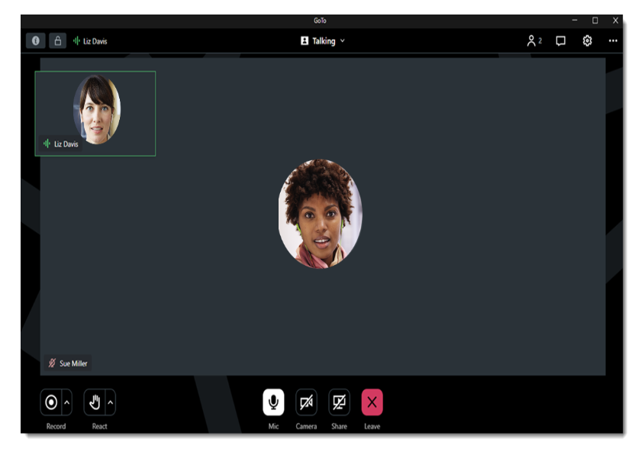
GoToMeeting Housekeeping: What You See as an Attendee
Change your view and how you see participants and speakers
Chat box
Raise your hand and other reactions
Mic (mute) and Camera

Slide 3
GoToMeeting Housekeeping: What You See as an Attendee
Use the Push Pin icon to pin the slideshow to make it the main screen

Slide 4
GoToMeeting Housekeeping: What You See as an Attendee
Then it should be the main screen

Slide 5
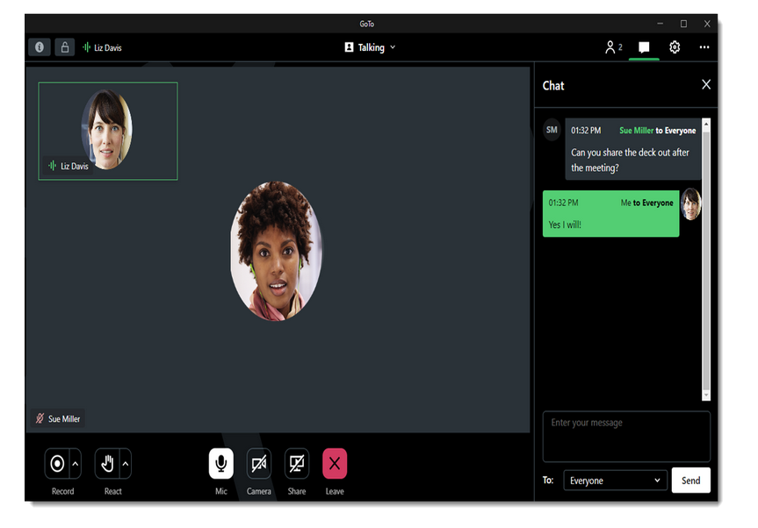
Roll Call
Please enter the following information in the chat for our attendance records:
Name
Organization/Affiliation
Email Address
diabetesnc.com/diabetes-advisory-council/
Notes:
Everyone needs to sign in using the link through this QR code – online and in-person.

Slide 6
Introductions and Welcome of New Members

Slide 7
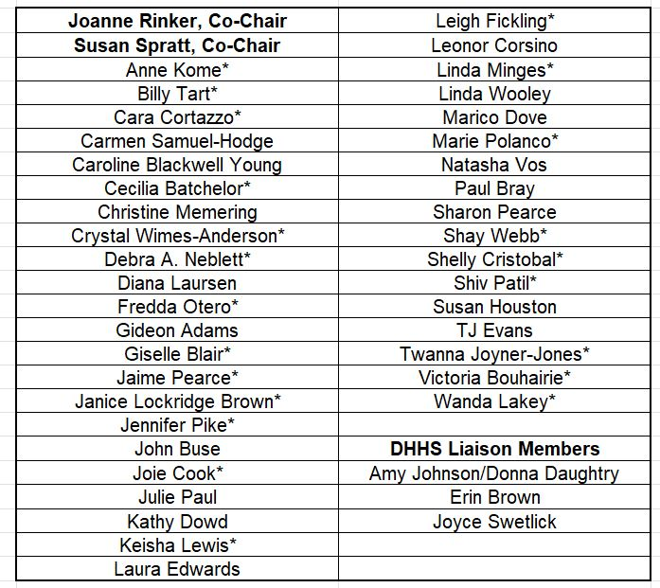
DAC Voting Members
*Indicates a new member
Notes:
Updated list of DAC members. Those with a star next to their name are our newest members. If you don't see your name here, you are a collaborator.

Slide 8
Don’t Forget to Sign In!
This meeting will offer the opportunity for participants to earn Continuing Education Unit (CEU) credits. Some professionals may be eligible to receive credits based on their specific credentials. Participants whose credentials are not explicitly listed should consult their credentialing organization or certifying agency to confirm whether CEUs from this meeting will be accepted.
To receive CEUs for this meeting, please sign in using the QR code below.
Notes:
If you want CEUs, you have to be on our attendance sheet and the only way is through this online link. We will not be noting who is in the room or on virtually. Pharmacists will need to include their NABP and PIN numbers on the attendance form. One of the CE credit options listed is for IACET credits Those cover many allied healthcare professionals including dietitians, exercise physiologists, licensed clinical social workers, pharmacy technicians, audiologists, community health workers, among others.

Slide 9
Agenda
Welcome, Introductions and Review and Approval of February 2025 Highlights
Announcements
2024 DAC Scholarship Recipient
Clinic to Community Linkages, Diabetes Prevention Program
Break
Shifting your mindset: Providing Culturally Relevant Diabetes Nutrition Education
Mastering Medication Access and Affordability: Diabetes Edition
Meeting Wrap-Up & Action Items
Notes:
Will be trying to stick to the time as closely as possible because we have a packed agenda today!

Slide 10
diabetesnc.com/diabetes-advisory-council/
Notes:
You can find previous meeting highlights on the DAC webpage here if you don't take a look at them in the follow up email that goes out after our meetings.

Slide 11
DAC Voting Members
Notes:
And with that we can go ahead and vote on the previous meeting's minutes. Only those on this list can vote.

Slide 12
Announcements
Dr. Susan Spratt
Joanne Rinker

Slide 13
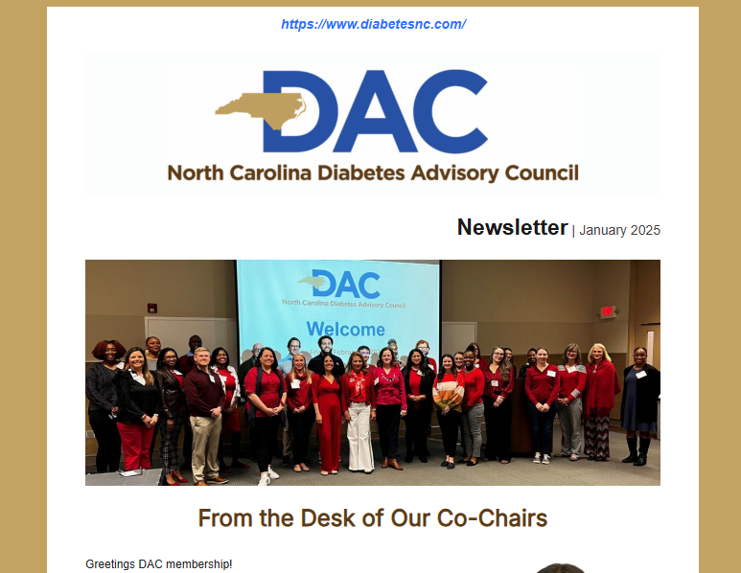
DAC Newsletter
Thank you to everyone who contributed to the Spring DAC Newsletter!

Slide 14
Diabetes Summer Camps
Diabetes Adventure Camp | June 19-22 | Parkton, NC
Camp Morris | June 22-28 | King, NC
Camp Kudos | July 18-20 | Fort Mill, South Carolina
Camp Carolina Trails | August 3-7 | Randleman, North Carolina
Notes:
Great volunteer opportunities and they're always looking for help

Slide 15
TAP Cohort Meeting
Notes:
Announcement from Kathy Dowd

Slide 16
Healthy Opportunities Pilots
Advocacy Day
June 4, 2025
Notes:
On June 4, 2025, Human Service Organizations for the Healthy Opportunities Pilots are coming together to share the importance of the Pilots with legislators at the North Carolina General Assembly. This is a critical moment to share what we know to be true: HOP works! Providing evidence-based supports for housing, food, and safety delivers an outsized impact on people, communities, and the cost of health care. This good work needs to be sustained, and your advocacy can help."

Slide 17
Policy Update
Monica Billger American Diabetes Association
Notes:
Brief updates on Maryland bill and work going on in NC

Slide 18
2025 DAC Meeting Dates
October 3, 2025
DAC Awards and Scholarship Presentation Ceremony
&
Research Poster Display
Meeting will be held at the McKimmon Center in Raleigh with a virtual option.
Notes:
DAC Awards Presentation in October
Announcement about Research Poster Displays at that meeting as well. Following the meeting, a link will go out to submit your research poster for display. Submissions will need to be in by September 12 and you'll be notified of approval by September 26.

Slide 19
2025 DAC Awards
Nominations for the 2025 DAC Awards are open from May 1 through July 31
Applications can be found on www.diabetesnc.com
We’re looking for 3 volunteers to serve on the DAC Awards Review Committee
Notes:
The DAC Awards are open now through July 31. Need 3 volunteers to be on review committee

Slide 20
2024 DAC Hugh Young Diabetes Care and Education Specialist Scholarship Recipient
Lynsi Beers, RD, LDN
Pinehurst Medical Clinic
Notes:
Lynsi Beers from Pinehurst Medical Clinic was the 2024 recipient of the Hugh Young Diabetes Care and Education Specialist Scholarship. She had a last minute scheduling conflict and could not make it in-person, but you can read about her experience at 2024 ADCES Diabetes Technology Conference in the most recent edition of the DAC Newsletter.

Slide 21
Join a Workgroup and Get Involved!
Membership Engagement: Supports the NC Diabetes Advisory Council by reviewing membership applications, recommending qualified candidates, and identifying partners to promote diverse, inclusive representation and statewide impact.
T1D: Monitors trends, identifies unmet needs, and guides strategies to improve awareness, care, and outcomes for individuals with type 1 diabetes in North Carolina.
Diabetes Guide Promotion and Outreach: Leads efforts to increase awareness and utilization of the North Carolina Guide to the Prevention and Management of Diabetes.
Emerging Science and Evidence: Tracks emerging research and innovations in diabetes care, identifying key topics, thought leaders, and DAC meeting speaker recommendations to keep the Council’s work timely, evidence-based, and impactful.
Notes:
Thank you to everyone who help with the previous workgroups and the chairs of those groups. We are sunsetting those workgroups and starting 4 new ones.
QR code here goes to the sign up page to join one of these workgroups and to let us know if you're interested in chairing or co-chairing one of these workgroups

Slide 22
Join a Workgroup and Get Involved!
Anticipated Time Commitment: 4 – 6 hours a year
First Workgroup Meetings: Wednesday, June 18
8:00 – 8:30am Membership Engagement Workgroup
8:30 – 9:00am Type 1 Diabetes Trends and Needs Workgroup
9:00 – 9:30am Diabetes Guide Outreach and Evaluation Workgroup
9:30 – 10:00am Emerging Science and Evidence Workgroup
Notes:
The work ebbs and flows, but the time commitment is excepted to be about 4-6 hours a year. We already have our first meetings scheduled. If you can't attend these meetings, but still want to join a group, please still sign up!

Slide 23
Clinic to Community Linkages, Diabetes Prevention Program
Kat Combs, MPH
YMCA of the Triangle

Slide 24
Break 10 minutes

Slide 25
Shifting Your Mindset: Providing Culturally Relevant Diabetes Nutrition Education
Jasmine Westbrooks-Figaro, MS,RD,LDN,CDCES
Eatwell Exchange

Slide 26
Mastering Medication Access and Affordability: Diabetes Edition
Anne Komé , PharmD
UNC Health

Slide 27
Proposed Medicaid Cuts and Call to Action
Notes:
Possibly make these action items for a workgroup
Budget reconciliation process
Budget reconciliation is a procedural maneuver that allows the Senate to pass legislation with a simple majority rather than 60 votes.
Early Thursday morning, the House passed the reconciliation bill by a vote of 215-214.
Some key provisions:
Significant savings found in the Medicaid program – one major proposal is the first ever mandatory work requirement for Medicaid recipients, as well as financial penalties for states that provide Medicaid coverage for people who are not lawfully residing in the US
Require states to cover some of the costs in the SNAP programs
Full list of Medicaid provisions
The bill will be considered by the Senate after the Memorial Day recess, and it was likely they will vote on the bill by the end of June.
Given the different rules in each chamber, it is unclear how much the bill will change when it goes to the Senate floor.

Slide 28
Meeting Wrap-Up & Action Items
CEU Attendance Sheet and Duke Portal Registration
Pharmacists need to claim their credits within 60 days
Duke Portal registration is due by May 30, 2025.
Sign-up for a Workgroup
Nominate someone for the 2025 DAC Awards and Scholarship
Get your research posters ready for October and submit request to present

Slide 29
Upcoming DAC Meetings
Friday, October 3, 2025
In-Person at The McKimmon Center for Extension and Continuing Education
1101 Gorman Street, Raleigh, NC 27606
Virtual Option Available
diabetesnc.com/diabetes-advisory-council

