Slide 1

Welcome
Friday, October 3, 2025
Notes:
We will be starting on time

Slide 2
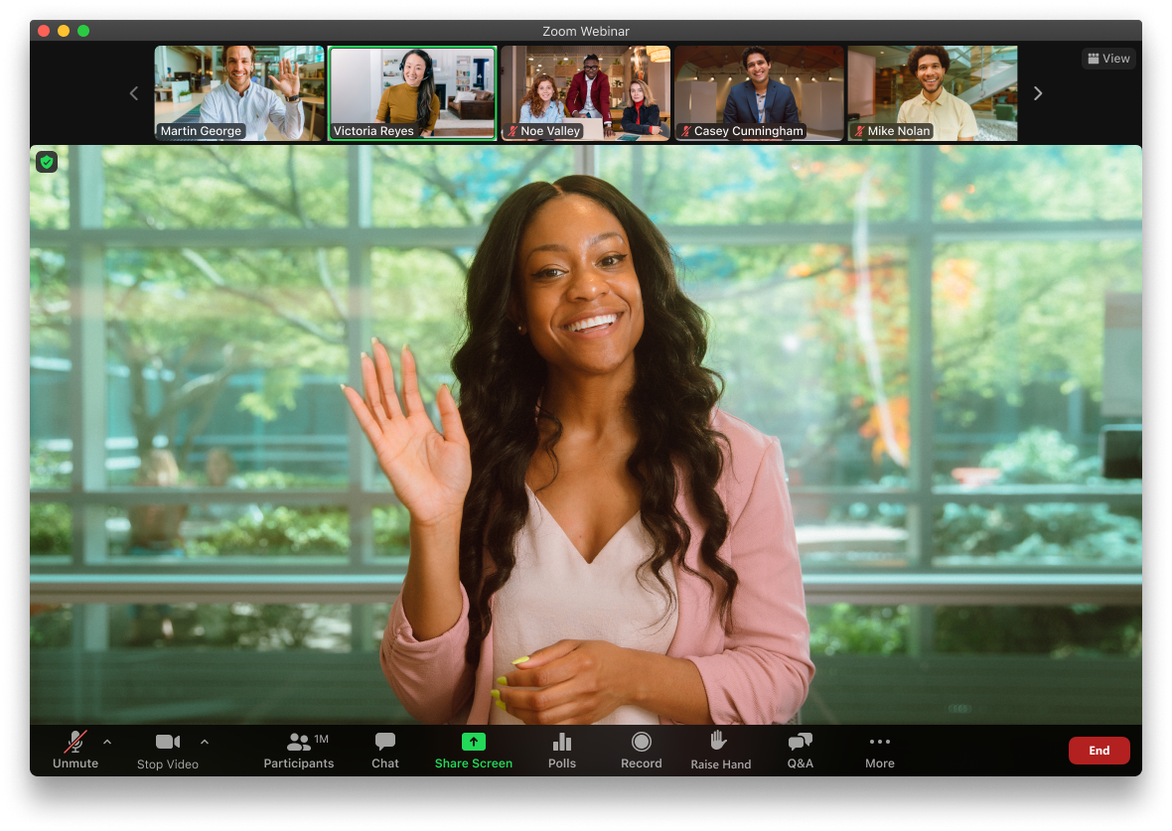
Zoom Housekeeping: What You See as an Attendee
Change your view and how you see participants and speakers
Raise your hand
Chat box
Mic (mute) and Camera

Slide 3
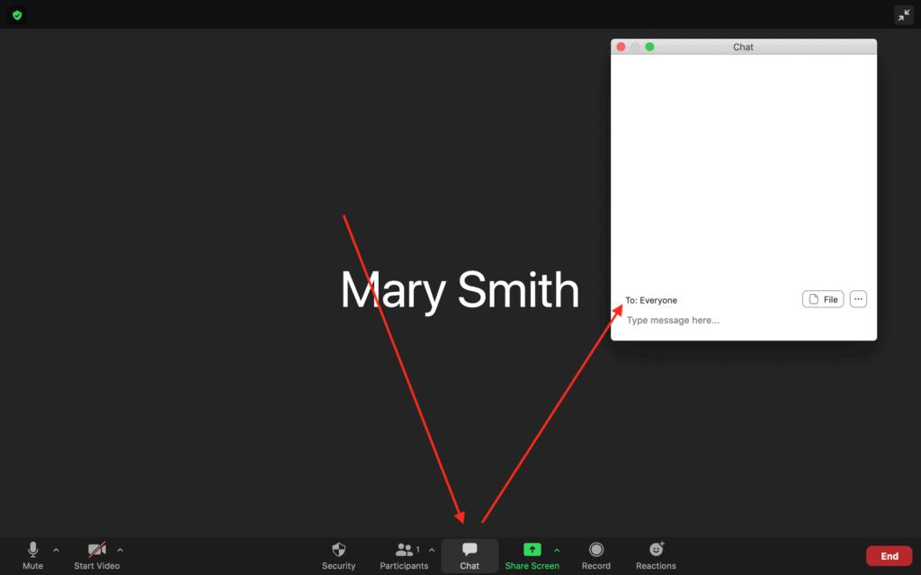
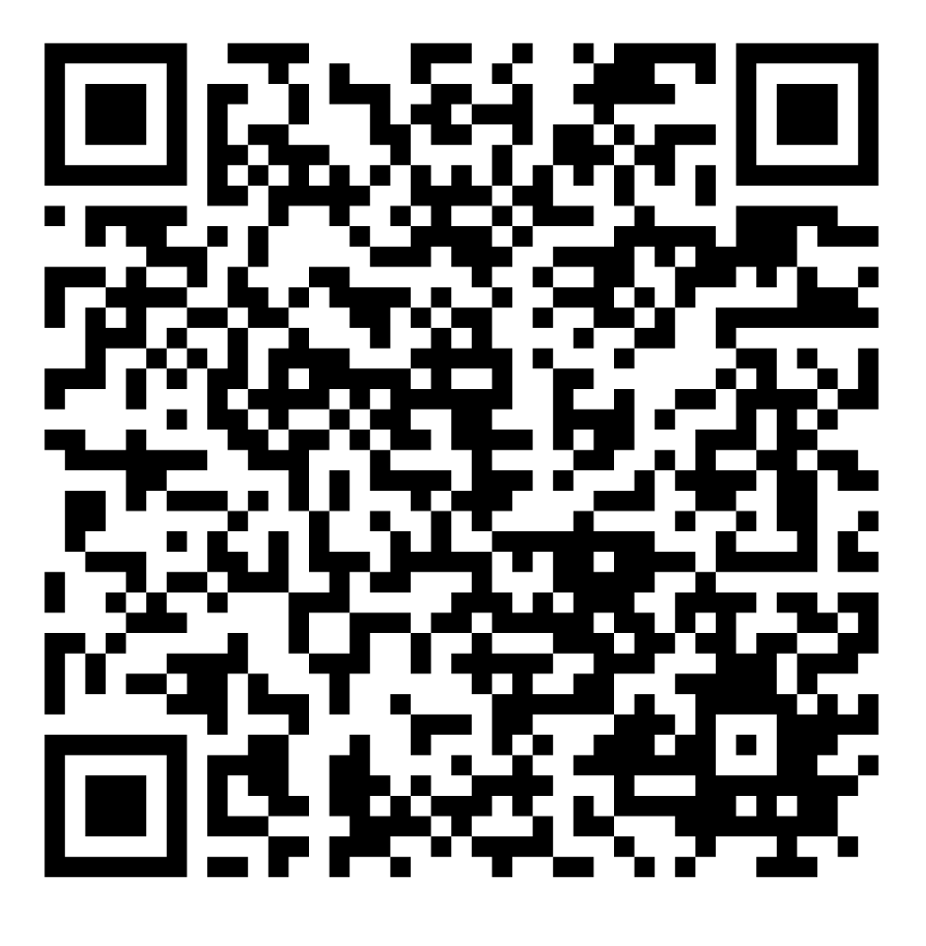
Roll Call
Please enter the following information in the chat for our attendance records:
Name
Organization/Affiliation
Email Address
diabetesnc.com/diabetes-advisory-council/
Notes:
Everyone needs to sign in using the link through this QR code – online and in-person.

Slide 4
Don’t Forget to Sign In!
This meeting will offer the opportunity for participants to earn Continuing Education Unit (CEU) credits. Some professionals may be eligible to receive credits based on their specific credentials. Participants whose credentials are not explicitly listed should consult their credentialing organization or certifying agency to confirm whether CEUs from this meeting will be accepted.
To receive CEUs for this meeting, please sign in using the QR code below.
Notes:
If you want CEUs, you have to be on our attendance sheet and the only way is through this online link. We will not be noting who is in the room or on virtually. Pharmacists will need to include their NABP and PIN numbers on the attendance form. One of the CE credit options listed is for IACET credits Those cover many allied healthcare professionals including dietitians, exercise physiologists, licensed clinical social workers, pharmacy technicians, audiologists, community health workers, among others.

Slide 5
Agenda
Welcome, Introductions and Review and Approval of May 2025 Highlights
Announcements
Innovations in Diabetes Care
Poster Review
Workgroup Updates
Diabetes Self-Management Education and Support (DSMES) and Diabetes Prevention Program (DPP) Updates
2025 DAC Awards and Scholarship Presentation and Ceremony
Meeting Wrap-Up & Action Items
Notes:
Will be trying to stick to the time as closely as possible because we have a packed agenda today!

Slide 6
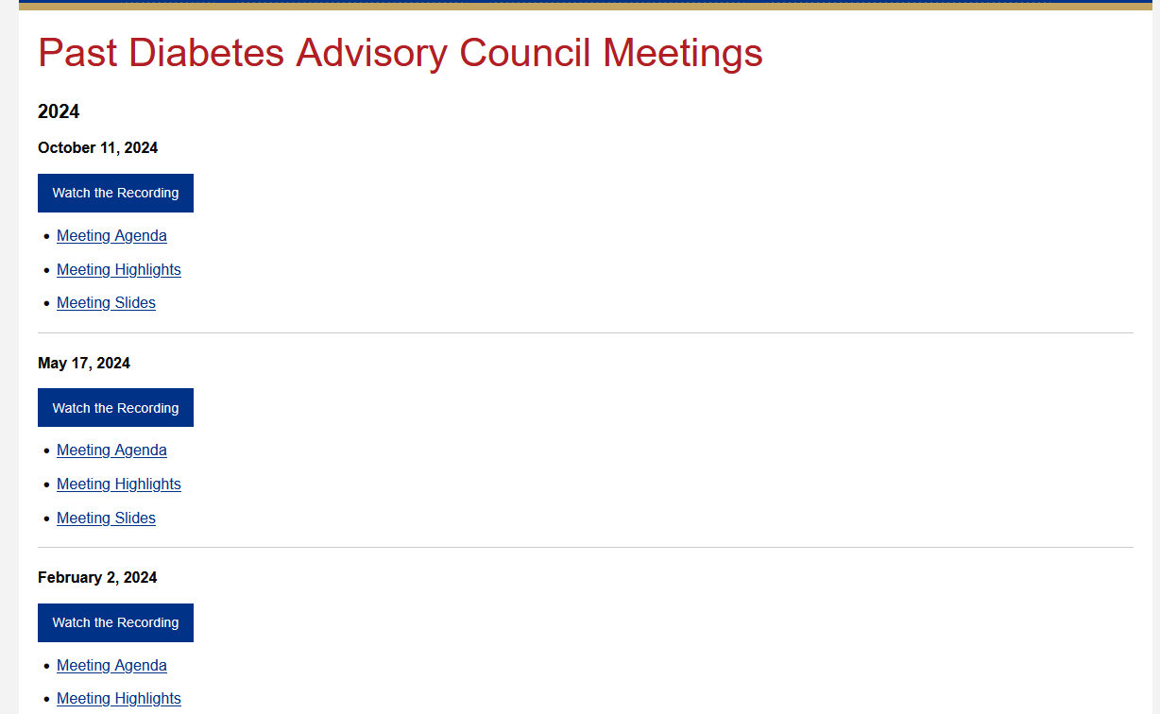
diabetesnc.com/diabetes-advisory-council/
Notes:
You can find previous meeting highlights on the DAC webpage here if you don't take a look at them in the follow up email that goes out after our meetings.

Slide 7
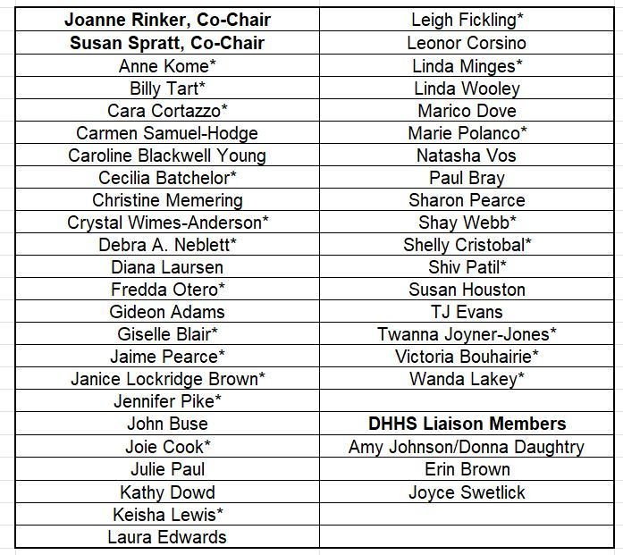
DAC Voting Members
Notes:
And with that we can go ahead and vote on the previous meeting's minutes. Only those on this list can vote.

Slide 8
Announcements
Dr. Susan Spratt
Joanne Rinker

Slide 9
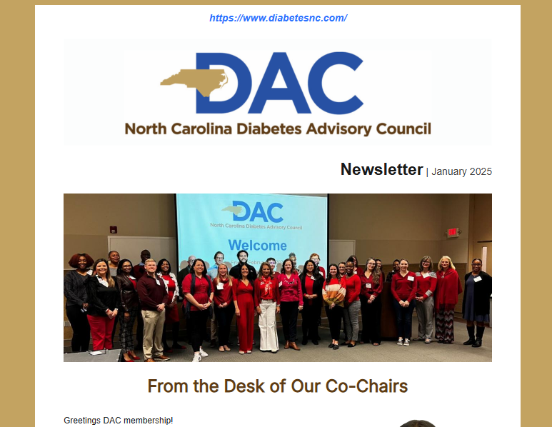
DAC Newsletter
The Fall DAC Newsletter will be released in mid-October. If you’d like to contribute, please email Dominique at dominique.ashley@dhhs.nc.gov

Slide 10
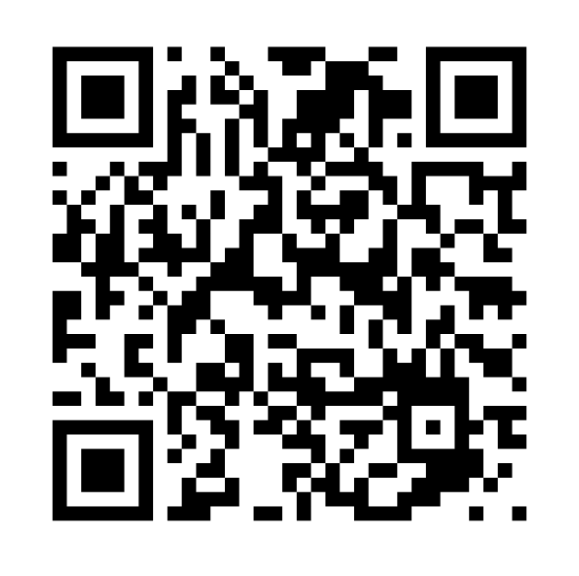
Join a Workgroup and Get Involved!
Membership Engagement
T1D Trends and Needs
Emerging Science and Evidence
Advocacy and Policy Workgroup
Notes:
Thank you to everyone who help with the previous workgroups and the chairs of those groups. We are sunsetting those workgroups and starting 4 new ones.
QR code here goes to the sign up page to join one of these workgroups and to let us know if you're interested in chairing or co-chairing one of these workgroups

Slide 11
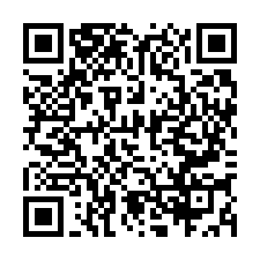
2025 DAC Membership Survey
Please take a moment to complete the annual DAC Membership Survey for 2025. Your responses are essential for helping us improve as an advisory council and for our efforts to reduce the burden of diabetes in North Carolina.

Slide 12
2026 DAC Meetings
February 27th
May 29th
October TBD

Slide 13
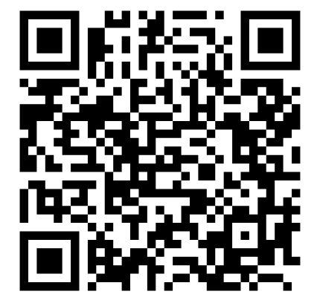
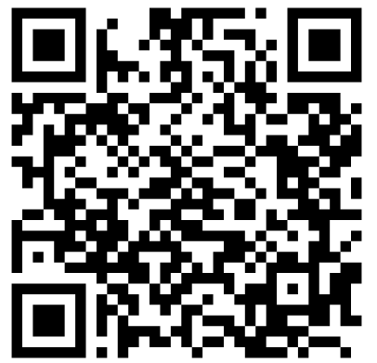
2025 State of Diabetes
Raleigh-Durham
North Carolina Central University
11/03/2025
11:00 AM - 2:00 PM
Charlotte
Northeastern University
11/06/2025
9:00 AM - 12:00 PM
Notes:
Ask TJ Evans if he wants to add anything

Slide 14
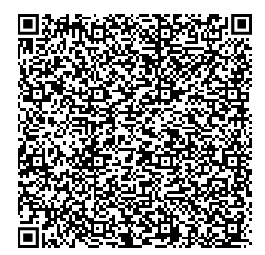
ADCES Diabetes Technology Conference
December 12 – 13
Chicago
Scholarship opportunity through ADCES Foundation

Slide 15
Innovations in Diabetes Care
John Buse, MD, PhD
University of North Carolina School of Medicine

Slide 16
Poster Review 30 minutes

Slide 17
Workgroup Updates
T1D Trends and Needs
Cara Cortazzo, Sanofi
Emerging Science and Evidence
Claudia Giraldo, CCCPH

Slide 18
T1D Trends and Needs Workgroup
One-Page Resource​
​
Goals: Create an easy-to-use, NC-specific snapshot of T1D​
Audiences: legislators, decision-makers, leaders outside the T1D community​
Intent:​
Provide credible, concise NC data​
​
Build awareness without stigma​
​
Support advocacy conversations​
​
DAC February Meeting (T1D Focus)​
Goals:​
Share latest CGM technology and data​
​
Share screening and advocacy information ​
​
Next Steps for Workgroup​
​
Finalize & publish NC T1D one-pager​
​
Prepare DAC content & speakers for February meeting ​
​
Ongoing collaboration across NC partners

Slide 19


Slide 20
Diabetes Self-Management Education and Support (DSMES) Updates
Corissa Payton
DSMES Quality Coordinator
NC Department of Health and Human Services

Slide 21
DSMES in North Carolina
2024 Diabetes Self-Management Education and Support State Data Report
NC ranks in the top 10 states in the nation for DSMES
72 active programs | 6th highest in U.S. (behind only the largest like TX, CA, NY, OH, and FL)
32,634 participants | More than every Southeast state except FL
3.2% of adults with diabetes reached | 5th in the U.S. and above the national average of 3%
Notes:
The 2024 DSMES state data report from ADA and ADCES were recently released and the report shows the list of states, number new programs established (2), number of programs that closed (1), total programs (72), and total participants for 2024 (32,634). I do think these numbers can be a little deceiving and for NC in particular because of the umbrella program, under represented. So for example, in 2024 in DiabetesSmart the umbrella program we added 2 new organizations in 2024, but a total of 15 new sites from those new and already existing DiabetesSmart sites. But those wouldn't be counted in this report I don't think because the umbrella program is the site that is counted, and that was new. I think.
So we look at it and it looks like NC is doing pretty good, but if you do a deeper analysis what that shows is

Slide 22
CDC Diabetes Management Collaborative (DMC)
Diabetes Organizations
American Diabetes Association
Association of Diabetes Care and Education Specialists
Beyond Type 1
Children with Diabetes
Diabetes Leadership Council
DiabetesSisters
Diabetes by Design
Taking Control of Your Diabetes
Faith-Based Organizations
Balm in Gilead
Federal Agencies
Centers for Disease Control and Prevention Centers for Medicare & Medicaid Services (CMS)
Department of Defense
Department of Veteran Affairs
Indian Health Services
Universities/Medical Schools
University of Illinois Chicago (UIC) Diabetes Empowerment Education Program (DEEP)
Population-Focused Health Organizations
American Association on Health and Disability
American Psychological Association
Association of Asian Pacific Community Health Organizations
Black Women's Health Imperative
Migrant Clinicians Network
National Alliance for Hispanic Health
National Association of Pasifika Organizations
National Black Nurses Association
National Center for Rural Health Professions
National Indian Health Board
National Medical Association
Community Health Workers (CHWs)
American Public Health Association (APHA) CHW Section Training and TA Committee
National Association of Community Health Workers
Health Care Provider/Medical Professional National Organizations
American Academy of Family Physicians
American Academy of Physician Associates
American Association of clinical Endocrinologists
American Association of Nurse Practitioners
Community Pharmacy Enhances Services Network
The Endocrine Society
Other Health Care/Public Health Organizations
American Public Health Association
Illinois Department of Public Health
Kentucky Department for Public Health
National Association of Chronic Disease Directors
National Association of Community Health Centers
National Association of Health Services Executives
North Carolina Department of Health and Human Services
The Audiology Project
University of Maryland Captial Region Medical Center

Slide 23
CDC Diabetes Management Collaborative (DMC)
DMC Key Milestone & Achievements: June 2024 – August 2025
June 2024: Two day forum in Chicago. NC is one of three states invited to join DMC.
August and September 2024: Reviewed and finalized mission, vision, values, and guiding principles.
October 2024: Member Meeting - Established 5 initial workgroups
Big Ideas & Disruptive Approaches; Government Agencies; Operations; Priorities for Action; Vision and Values
November 2024 to March 2025: Monthly workgroup meetings - developed proposals, generated potential "big ideas," gathered information, and evaluated over 100 priorities
April 2025: Member Meeting - Adopted operational guidelines and 4 initial priorities for action
Eliminate/expand referral requirement; Ensure all PWD and those at risk are covered; Increase awareness of DSMES, Lower barriers to telehealth

Slide 24
CDC Diabetes Management Collaborative (DMC)
DMC Key Milestone & Achievements: June 2024 – August 2025
May 2025: Steering Committee Meeting – Marked a transition from ideation to action
July 2025: Member Meeting – Legislation briefing, voted to continue exploring diabetes management hub website idea, provided feedback on DMC, and created 6 new workgroups
DSMES Awareness Campaign; DSMES Referral Requirements; Hub Website; Insurance Coverage; Policy Agenda; Telehealth Access to DSMES
Notes:
Can we bring up the pdf here to show the timeline?

Slide 25
Diabetes Prevention Program (DPP) Updates
Meg Sargent
Diabetes Prevention Program Coordinator
NC Department of Health and Human Services

Slide 26
DPP in NC
66 CDC recognized DPP programs in NC
Decrease of DPPs in NC in recent years due to lack of funding
Current pathways to payment/reimbursement:
Medicare (must be approved as a Medicare DPP site)
Managed Care Organizations: WellCare and UnitedHealth
Self-pay (often with sliding fee schedule)
Action steps:
Convening of DPP coordinators statewide to discuss feasible/reasonable reimbursement strategies

Slide 27
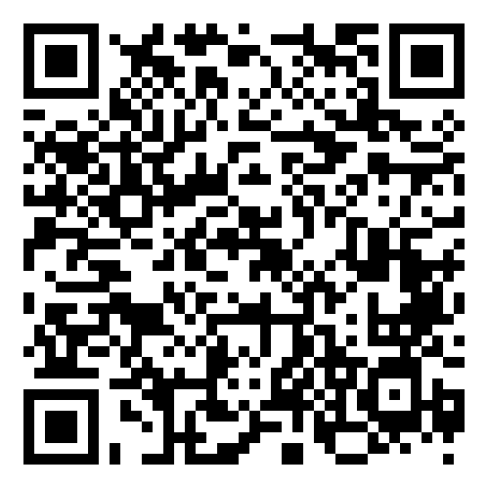
CHWs in Diabetes Prevention and Management
A community health worker (CHW) is a frontline public health worker who is a trusted member of and/or has an unusually close understanding of the community served.
CHWs can help with:
-Care coordination (SDOH screenings, referrals, navigators, follow-up care)
-Health education (Cultural competence, promoting healthy behaviors, health literacy gaps)
-Data collection and community assessments (needs assessments, research, community feedback)
Email Meg Sargent at Meg.Sargent@dhhs.nc.gov
if you want to learn more about/work with CHWs
NC CHW Employer Survey

Slide 28
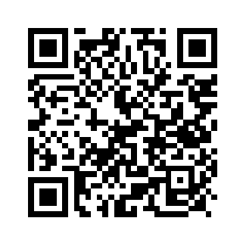

NC Diabetes Prevention and Management Pharmacy Collaborative
Who: Anyone in the pharmacy field who is interested in diabetes prevention and management work
When: Wednesday, January 7, 2026 at 10:00 AM
Sign up here to receive monthly DPP updates including updates/registration information about the pharmacy collaborative

Slide 29
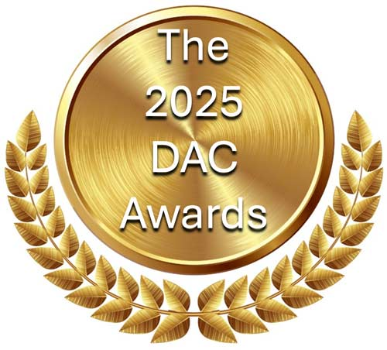

Slide 30

Hugh Young Diabetes Care and Education Specialist Scholarship
Lisa Duffy, BSN, RN

Slide 31
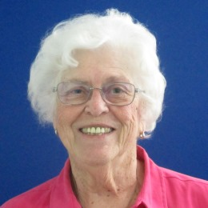
John Bowdish Community Award
Sue B. Liverman, RN, CDCES

Slide 32
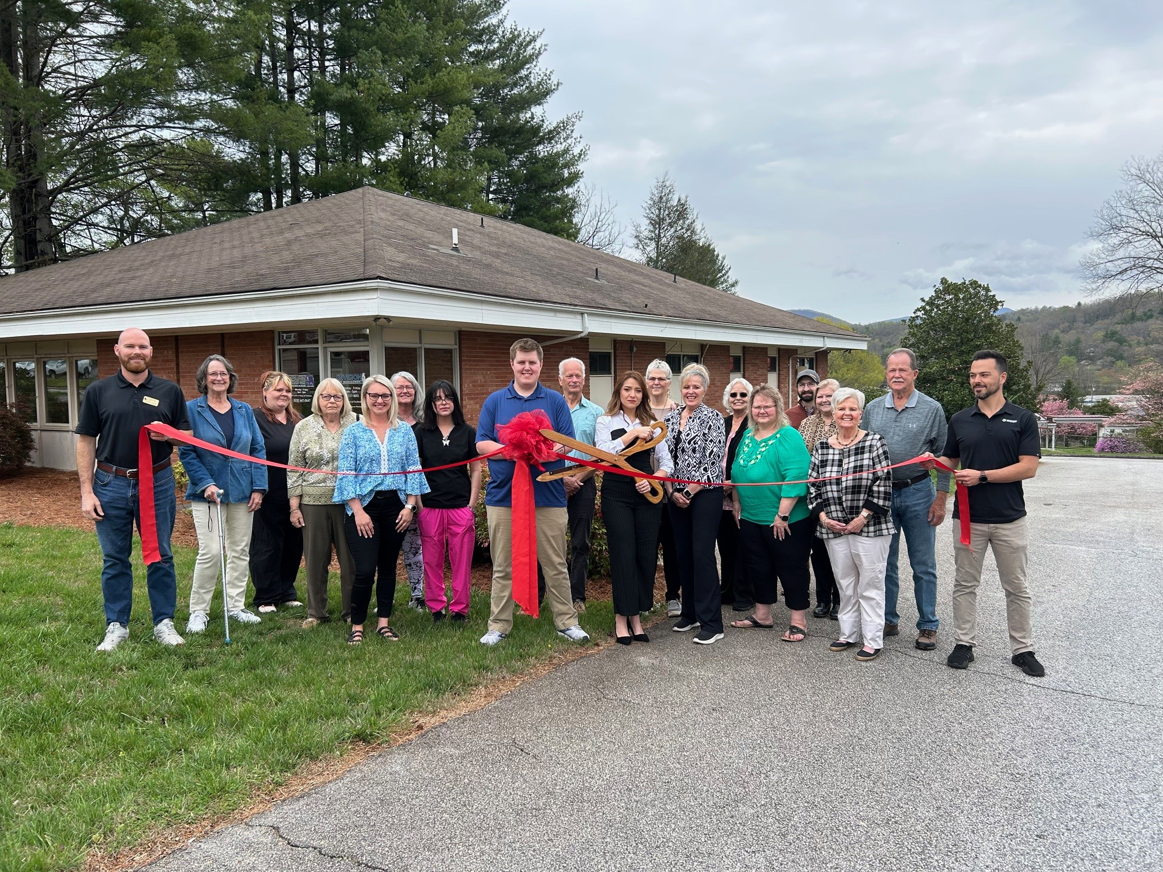
Health Care Provider Award
Community Care Clinic of Franklin

Slide 33
Meeting Wrap-Up & Action Items
CEU Attendance Sheet and Duke Portal Registration
Pharmacists need to claim their credits within 60 days
Duke Portal registration is due by October 10, 2025.

Slide 34
Upcoming DAC Meetings
Friday, February 27, 2026
In-Person at The McKimmon Center for Extension and Continuing Education
1101 Gorman Street, Raleigh, NC 27606
Virtual Option Available
diabetesnc.com/diabetes-advisory-council

