Slide 1

Welcome
Friday, February 27, 2026
Notes:
We will be starting on time

Slide 2
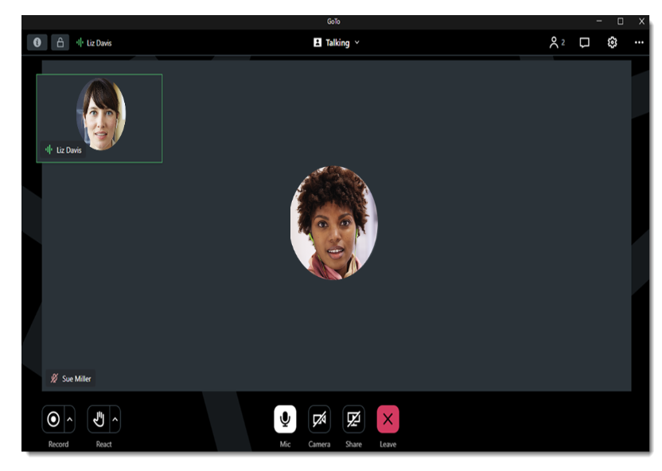
GoToMeeting Housekeeping: What You See as an Attendee
Change your view and how you see participants and speakers
Chat box
Raise your hand and other reactions
Mic (mute) and Camera

Slide 3
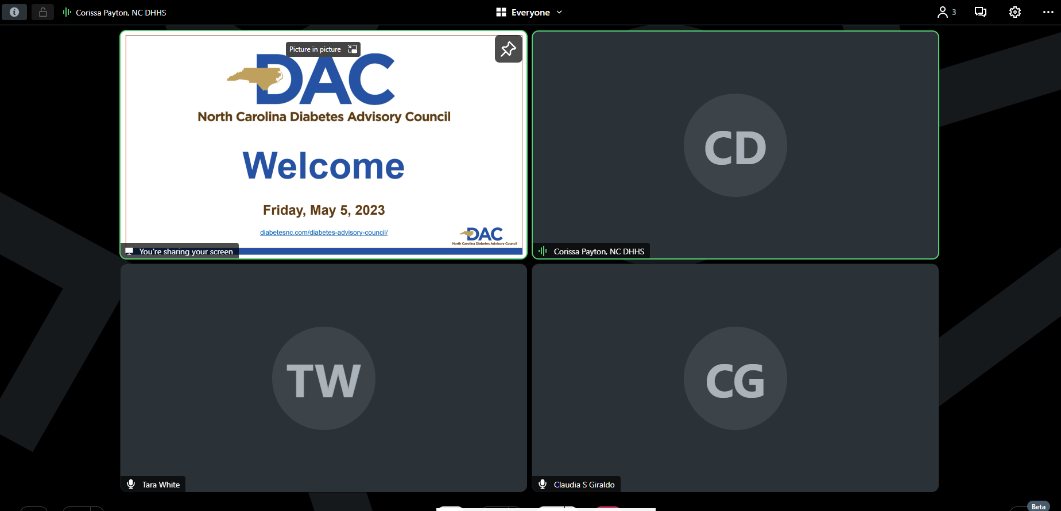
GoToMeeting Housekeeping: What You See as an Attendee
Use the Push Pin icon to pin the slideshow to make it the main screen

Slide 4
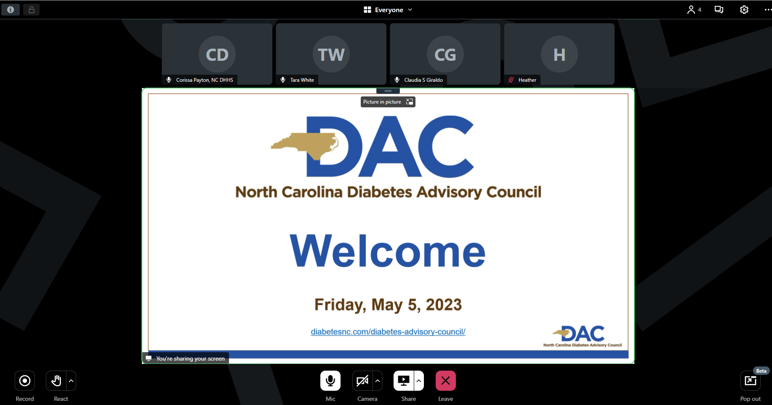
GoToMeeting Housekeeping: What You See as an Attendee
Then it should be the main screen

Slide 5
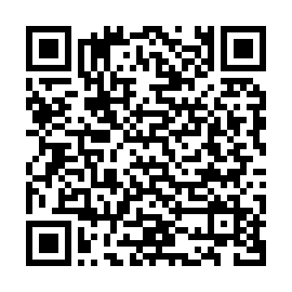
Don’t Forget to Sign In!
This meeting will offer the opportunity for participants to earn Continuing Education Unit (CEU) credits. Some professionals may be eligible to receive credits based on their specific credentials. Participants whose credentials are not explicitly listed should consult their credentialing organization or certifying agency to confirm whether CEUs from this meeting will be accepted.
To receive CEUs for this meeting, please sign in using the QR code below.
Notes:
If you want CEUs, you have to be on our attendance sheet and the only way is through this online link. We will not be noting who is in the room or on virtually. Pharmacists will need to include their NABP and PIN numbers on the attendance form. One of the CE credit options listed is for IACET credits Those cover many allied healthcare professionals including dietitians, exercise physiologists, licensed clinical social workers, pharmacy technicians, audiologists, community health workers, among others.

Slide 6
Agenda
Welcome, Introductions and Review and Approval of October 2025 Highlights
Announcements
Membership Survey Results
Clinical Application of Continuous Glucose Monitoring System Data
Type 1 Diabetes: A Paradigm Shift to Early Screening and Treatment
NCDHHS and NCMEDICAID Support Excellence in Diabetes Care
Workgroup Updates
Meeting Wrap-Up & Action Items
Notes:
Will be trying to stick to the time as closely as possible because we have a packed agenda today!

Slide 7
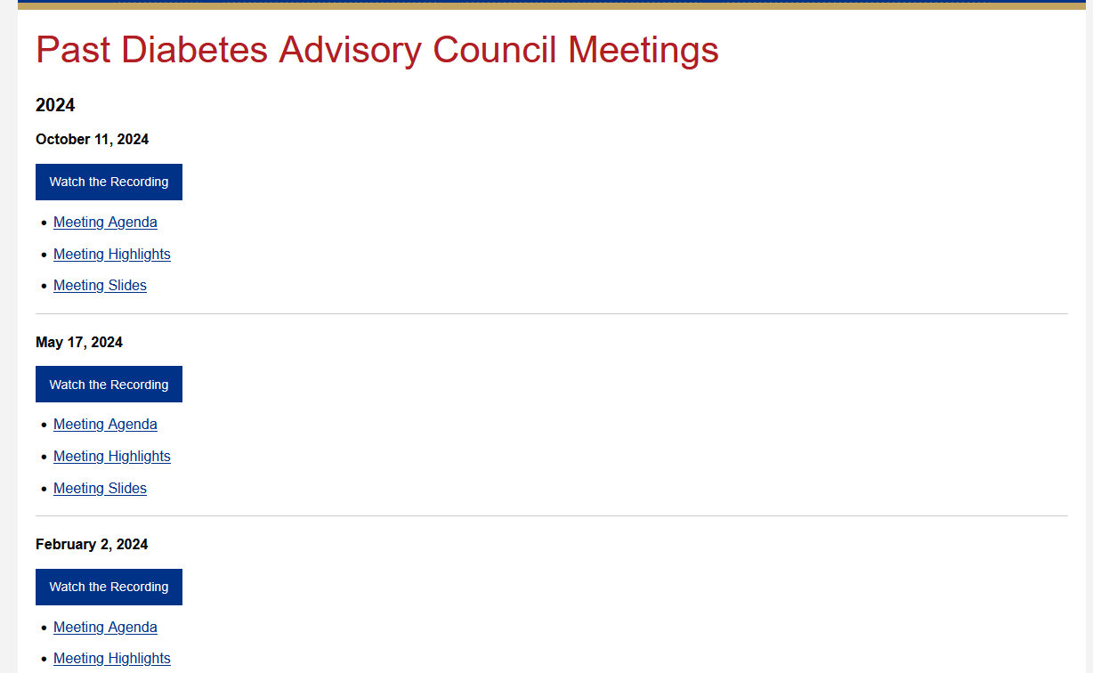
diabetesnc.com/diabetes-advisory-council/
Notes:
You can find previous meeting highlights on the DAC webpage here if you don't take a look at them in the follow up email that goes out after our meetings.

Slide 8
DAC Voting Members
Anne Kome
Billy Tart
Carmen D. Samuel-Hodge
Caroline Blackwell
Cecilia Batchelor
Chris Memering
Crystal Wimes-Anderson
Debra Neblett
Diana Laursen
Giselle Blair
Jaime Pearce
Janice Lockridge Brown
Jennifer Pike
**Joanne Rinker
John Buse
Julie Paul
Kathy Dowd
Keisha Lewis
Laura Edwards
Leigh Fickling
Leonor Corsino
Linda Wooley
Marico Dove
Marie Polanco
Meri Mitchell
Paul Bray
Sara Clement
Sara W. Foreman
Sharon Pearce
Shay Webb
Susan “Susie” Houston
**Susan E. Spratt
Teju Lakkundi
TJ Evans
Twanna Joyner Jones
Wanda Lakey
Notes:
And with that we can go ahead and vote on the previous meeting's minutes. Only those on this list can vote.

Slide 9
Announcements
Dr. Susan Spratt
Joanne Rinker

Slide 10
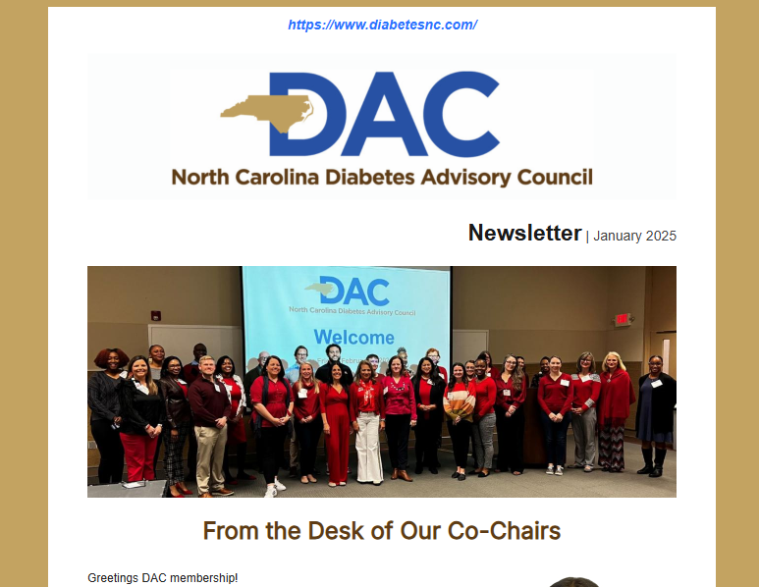
DAC Newsletter
The Winter Newsletter will be sent out during the first week of March.

Slide 11
National Standards for DSMES
Laura Edwards
laura.edwards@collaborativehealthsolutions.org

Slide 12
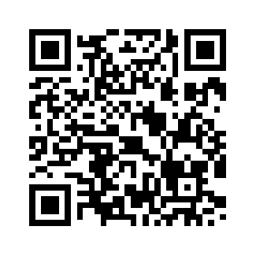
NC Diabetes Prevention and Management Pharmacy Collaborative
Presenter Opportunities:
Examples of requested topics:
Reimbursement strategies for services/programs
Community outreach
Remote monitoring opportunities
Other public health/pharmacy crossover topics to include diabetes work
Join the Listserv to stay in the loop:
Sign up for NC Diabetes Pharmacy Collab here or scan the QR code!
Contact Meg Sargent meg.sargent@dhhs.nc.gov

Slide 13
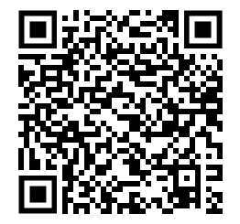
Diabetes Care and Education Conference 2026
March 6, 2026
8:00am – 5:00pm
Greenville, NC or virtual
Conference Overview:
Evidence-based updates on diabetes management
Latest ADA Standards of Care & CGM Advancements
Nutrition, obesity, and weight-loss strategies
Behavioral health integration in diabetes care
Access to clinical trials and islet cell transplants

Slide 14

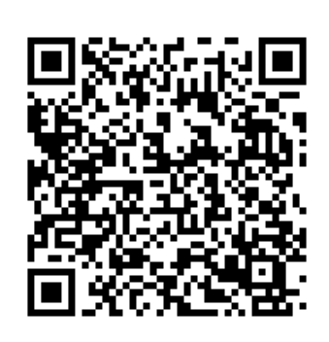
Winning With Diabetes Conference

Slide 15
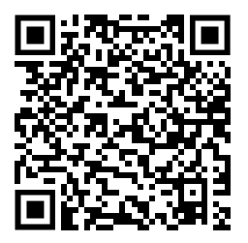
A-Z Diabetes Bootcamp 2026
April 6-10, 2026
Greenville, NC or Virtual
Conference Overview:
Week-long, intensive diabetes education program
Strengthens clinical knowledge & best practices
Based on current guidelines & evidence-based DSMES
Promote patient- and family- centered self-management relationships

Slide 16
State of The DAC
2025 DAC Membership Survey Summary
Key Findings & Insights
33 Submissions
Dr. Susan Spratt
Joanne Rinker

Slide 17
Respondent Overview
• Roles: Members, Collaborators, Invited Guests, Unsure
• Majority female respondents
• Predominantly White, with Black/African American and Hispanic/Latinx representation
• Participation ranged from new members to 25-year participants
• Most respondents participated 0–2 years

Slide 18
Key Strengths
• Strong clarity of DAC mission and purpose
• High confidence in DAC leadership
• Strong commitment to health equity
• Meetings viewed as productive and worthwhile
• Members feel comfortable expressing opinions

Slide 19
What Would Increase Engagement?
• Continuing Education (CE) credits (most requested)
• Workgroup participation
• Leadership opportunities
• Continued virtual/hybrid options
• Advocacy training
• Clearer workgroup descriptions for new members

Slide 20
Suggested Focus Areas
• Improving diabetes management outcomes
• Increasing referrals
• Clinical & community care integration
• Behavioral health & comorbidities
• Lifestyle medicine & diabetes technology
• Type 1 diabetes, MASLD, metabolic syndrome
• Inclusion of individuals living with diabetes

Slide 21
Opportunities for Improvement
• Clarify membership expectations & onboarding
• Provide clearer action items after meetings
• Expand CE offerings (including LCSW credits)
• Increase strategies to engage invited guests
• Continue strengthening hybrid participation options

Slide 22
Clinical Application of Continuous Glucose Monitoring System Data
Michael Canos, MD, FACE, FACP, MPH, MSc
Duke University School of Medicine

Slide 23
Break
10 minutes

Slide 24
Type 1 Diabetes: A Paradigm Shift to Early Screening and Treatment
Jennifer Sutter, MD
East Carolina University

Slide 25
NCDHHS and NCMEDICAID Support Excellence in Diabetes Care
Lawerence Greenblatt, MD
North Carolina Department of Health and Human Services

Slide 26
Workgroup Updates

Slide 27
Advocacy and Policy Workgroup
Paul Bray

Slide 28
Membership Engagement

Slide 29
Type 1 Diabetes Trends & Needs
Cara Cortazzo

Slide 30
Emerging Science & Evidence

Slide 31
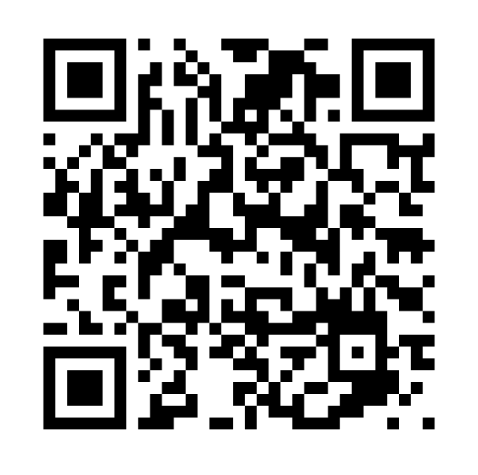
Join a Workgroup and Get Involved!
Membership Engagement
  March 24th | 9:00 AM
T1D Trends and Needs
  March 24th | 9:30 AM
Emerging Science and Evidence
Advocacy and Policy Workgroup
Notes:
Thank you to everyone who help with the previous workgroups and the chairs of those groups. We are sunsetting those workgroups and starting 4 new ones.
QR code here goes to the sign up page to join one of these workgroups and to let us know if you're interested in chairing or co-chairing one of these workgroups

Slide 32
Meeting Wrap-Up & Action Items
CEU Attendance Sheet and Duke Portal Registration
  Pharmacists need to claim their credits within 60 days

Slide 33
Upcoming DAC Meetings
Friday, May 29, 2026
In-Person at The McKimmon Center for Extension and Continuing Education
1101 Gorman Street, Raleigh, NC 27606
Virtual Option Available
diabetesnc.com/diabetes-advisory-council

